Slide 1
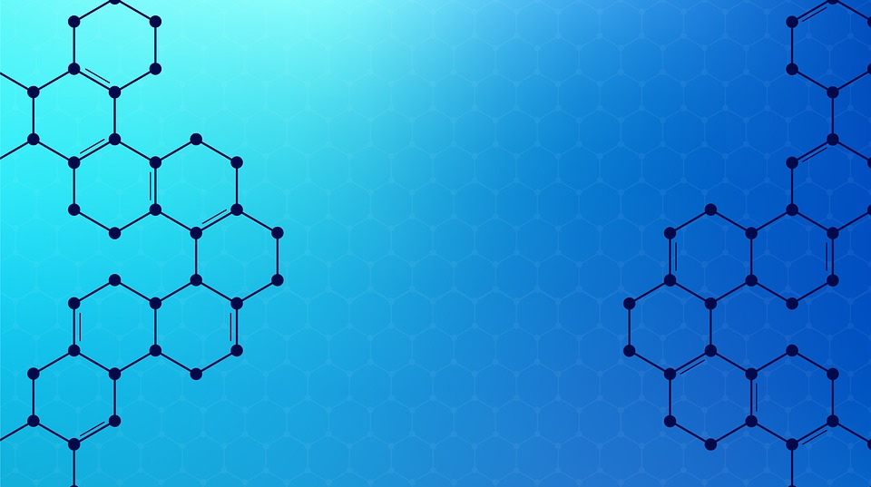
Why study science?
Citizens in Science

Slide 2
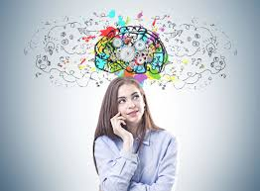
Why is science important?
Decision making
Humans are estimated to make 35,000 decisions a day.
Some of these are simple decisions/preferences.
Some depend on our feelings or emotions at the time.
Some depend on our faith or culture.
Some might be based on new information that we have to make a judgement on.
Notes:
Get pupils to think about where and how science is used in every day life.

Slide 3
Why is science important?
Decision making
As responsible citizens, we need to use our scientific knowledge and skills to help us make decisions that might affect:
our lives
the lives of others
the planet and environment.
Notes:
Get pupils to think about where and how science is used in every day life.

Slide 4
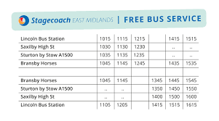
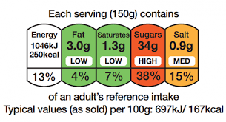
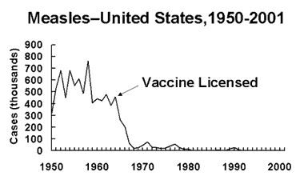
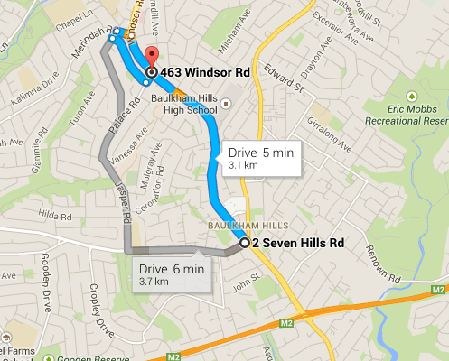
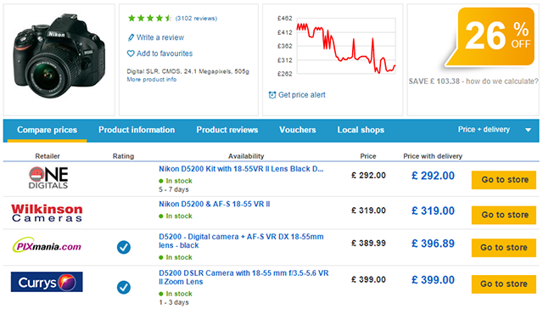
Why is science important?
Decision making
Many different things provide us with information to help us make informed decisions.
Look at the images and explain how they help people make informed decisions.
Notes:
Get pupils to think about where and how science is used in every day life.
Best before dates: which product should I buy, how long will it last, is it the same price as a product with a longer date?
Bus timetable: which bus will get me there quicker, which arrives at the right time, does it take the route I need?
Google map: which is the quickest route, busiest route, shortest route, what time will I arrive, what time do I need to set off?
Allergens advice: can I buy this food, what does it contain, where was it packaged and processed, will it make me ill?
Measles graph: do vaccines prevent disease, should I get vaccinated, should I get my family vaccinated?
Food nutrition label: is this food healthy, how much fat/salt etc. have I got in my diet, will this product help me to lose/gain weight?
Energy efficiency label: how efficient is this product, how much water does it use, how much electricity does it use, how much washing can it hold, how much noise does it make, how does it compare to other products?
Price comparison website: where can I buy this product, how much does it cost, where is the best discount?

Slide 5
Common misconceptions
I’m not good at Science.
My parents were not good at Science so neither am I.
I can’t use science in real life.
Science isn’t important in my life.
I won’t need GCSE science for the job I want to do.
Notes:
Discuss fixed and growth mindset.
Fixed mindset: reluctant to take on challenges; prefer to stay in your comfort zone; fearful of making mistakes; think it is important to 'look smart' in front of others; believe that talents and abilities are set in stone and that you either have them or you don’t.
Growth mindset: believe that talents can be developed; view mistakes as an opportunity to develop; are resilient; believe that effort creates success and think about how they learn.

Slide 6
Mindset of high achievers video
Video links to YouTube. We recommend that you embed.
Notes:
https://www.youtube.com/watch?v=GVG4wgCqeEQ
Click the picture to play the video. We suggest you embed this to avoid ads and pop up. We are not able to do this due to our copyright restrictions.

Slide 7
TASK: What jobs could science support?

Slide 8
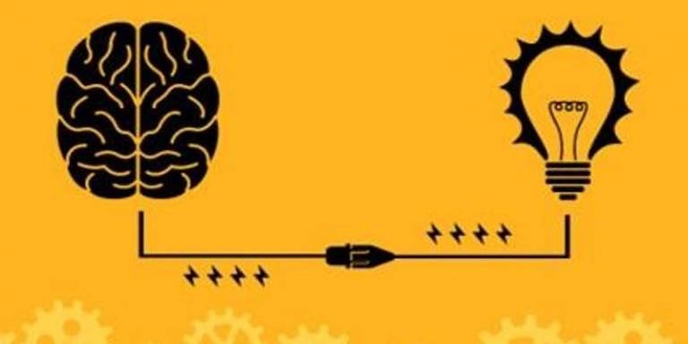
Careers Video
Video links to YouTube. We recommend that you embed.
Notes:
https://www.youtube.com/watch?v=VBxgRXw8heg
We recommend you embed the video to avoid ads and pop ups.

Slide 9
How does science develop character and culture?
Task: How has your character developed since Year 7?

Slide 10
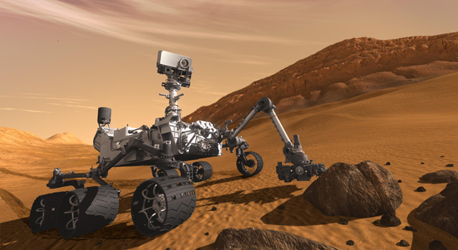
How does science develop character and culture?
Enquirer
Communicator
Work in a team
Think critically
Make informed judgements
Decision maker
Researcher
Notes:
Ask pupils to discuss how they think their character has developed throughout the school life. Are they enquirers? Communicators? Creative? etc
Emphasise that throughout their lives, they will need to make decisions informed by scientific reasoning.

Slide 11
How does science develop character and culture?
Researching and decision making
As responsible citizens we need to use our scientific knowledge and skills to help us make decisions that might affect:
Bees
Vaccines
Downs screening
GM products
Animal testing
Vegetarian/veganism
Diesel vs hybrid cars
Notes:
Get pupils to think about where and how science is used in every day life.

Slide 12
How does science develop character and culture?
You decide
Each research group will get two minutes to present their topic to the class:
You must present facts.
You must present reasons for and against.
You must not give your opinion.
Once each group has presented, the class will then vote, giving their own opinions based on the evidence presented.
We will then discuss questions after all groups have presented.
Notes:
Each group researches a topic area and reports back.
Slide summaries for each group are included at the end of the PowerPoint. There is a research grid to help students complete the research, if you feel they need this.

Slide 13
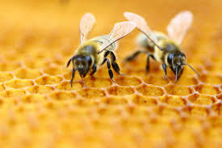
Success Criteria
Bees
The bee population has been rapidly declining for a number of years.
Use your research grid to complete the following success criteria:
State why bees so important to humans.
Describe some of the reasons bees might be decreasing.
Explain why this could be a problem to humans in the future.
Suggest how we can try to avoid/reduce/improve this situation.
Identify five ways this topic links to ideas you have learned about in science lessons.

Slide 14
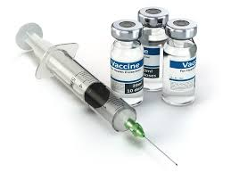
Success Criteria
2. Vaccination
Some people think vaccinations are unnecessary and that we don’t need to give them to children.
Use your research grid to complete the following success criteria:
State what vaccines do for our bodies.
Describe how vaccines provide immunity.
Explain why some people think vaccines are unnecessary or harmful.
Explain some of the risks and consequences of not having vaccines (hint: research measles, polio and small pox).
Identify five ways this topic links to ideas you have learned about in science lessons.
Notes:
For more able students, this task could be extended to look at the Wakefield MMR scare and the trend in vaccination data and measles outbreaks following the release of this (now disregarded) publication.

Slide 15
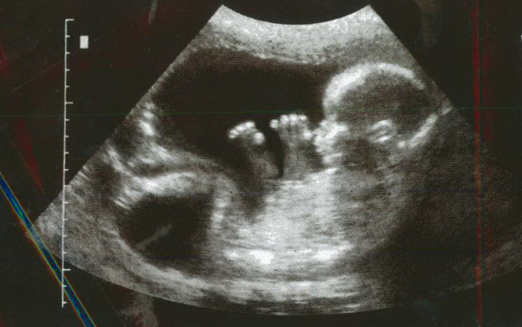
Success Criteria
3. Downs Syndrome screening
Downs Syndrome is a genetic disorder that people are born with. Pregnant women can have their babies tested for Downs Syndrome.
Use your research grid to complete the following success criteria:
Describe how Downs Syndrome affects people.
Explain some of the risks of amniocentesis.
Summarise the arguments for and against the testing for Downs Syndrome.
Identify five ways this topic links to ideas you have learned about in science lessons.

Slide 16
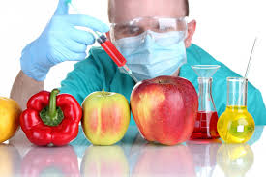
Success Criteria
4. GM Products
We can now change the genes of plants and animals to produce healthier, cheaper and larger quantities of food.
Use your research grid to complete the following success criteria:
Describe what GM or genetic engineering does to a cell.
Describe the arguments for and against GM.
Explain why this could be a problem to humans in the future.
Suggest how we can try to avoid/reduce/improve this situation.
Identify five ways this topic links to ideas you have learned about in science lessons.

Slide 17
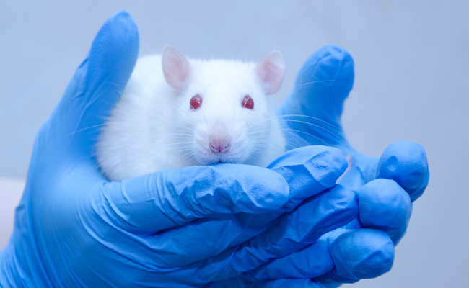
Success Criteria
5. Animal Testing
Scientists have used animals to test new products for nearly 100 years. Examples of things that have been tested on animals include: cosmetics (make up), organ transplants and vaccines.
Use your research grid to complete the following success criteria:
Give a range of examples of where animal testing is important to humans.
Describe why some people disagree with this.
Suggest how we can try to avoid/reduce/improve this situation.
Identify five ways this topic links to ideas you have learned about in science lessons.

Slide 18
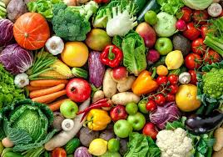
Success Criteria
6. Vegetarianism/Veganism
Globally, many people don’t get enough food to be healthy. Vegetarian/vegan diets can be a more efficient use of our planet’s resources.
Use your research grid to complete the following success criteria:
Give reasons why some people are vegetarian/vegan.
Describe how energy is lost from food chains.
Explain how a meat-eating diet loses more energy from the food chain.
Explain why this could be a problem to humans in the future.
Suggest how we can try to avoid/reduce/improve this situation.
Identify five ways this topic links to ideas you have learned about in science lessons.

Slide 19
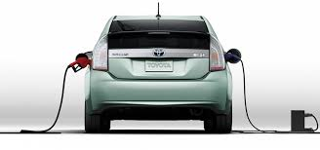
Success Criteria
7. Diesel vs hybrid cars
Oil is running out. Petrol is becoming more expensive. Diesel is a contributor to air pollution that can cause health problems.
Use your research grid to complete the following success criteria:
Describe why petrol or diesel is a non-renewable fuel.
Explain why hybrid cars are not completely pollution-free.
Describe some of the health benefits of changing our habits.
Explain why this could be a problem to humans in the future.
Suggest how we can try to avoid/reduce/improve this situation.
Identify five ways this topic links to ideas you have learned about in science lessons.

Slide 20
Suggested extension/research/homework tasks
Choose one of these skills and produce a presentation on a job where this skill is essential:
Evaluating risk (WS: Scientific attitudes)
Publishing results (WS: Scientific attitudes)
Design investigations of the real world (WS: Skills and investigations)
Carry out scientific tests (WS: Skills and investigations)
Carry out field work (WS: Skills and investigations)
Pay attention to health and safety (WS: Skills and investigations)
Apply mathematical concepts and calculate results (WS: Analysis and evaluation)
Present observations and data (WS: Analysis and evaluation)
Evaluate data, showing awareness of potential sources of error (WS: Analysis and evaluation)
Use data analysis and statistics (WS: Measurement)
Notes:
Students could complete the following tasks as an extension to the lesson or as directed tasks to complete throughout the year. These are closely matched to the 2013 Program of Study for science which, although no longer statutory, forms the back bone of most teaching sequences in KS3.

Slide 21
Additional resources and reading
http://www.futuremorph.org/teachers/teaching-resources/science-within-work/
An excellent set of 10 videos and accompanying resources that link modelling and practical activities to real life careers. These could be embedded once per half term or used as a STEM club/widening participation scheme.
http://www.rsc.org/careers/future/
Resources from the Royal Society of Chemistry, including board/specification links to careers and fields.
http://www.iop.org/education/teacher/student/index.html
Print and video resources linked to specific careers from the Institute of Physics.
https://www.rsb.org.uk/careers-and-cpd/careers/career-resources/resources-for-teachers
Resources from the Royal Society of Biology, including a series on activities of what a Biologist is – most suited to more able students.
https://imascientist.org.uk/
The annual opportunity to engage with scientists via live feeds.
Notes:
Students could complete the following tasks as an extension to the lesson or as directed tasks to complete throughout the year. These are closely matched to the 2013 Program of Study for science which, although no longer statutory, forms the back bone of most teaching sequences in KS3.

