Slide 1
Why Study Maths?

Slide 2
Why is Maths important?
What does it mean when we say “Maths is everywhere”?
Finance
Sports
Shopping/Sales
Mobiles/Tablets
Cooking
Fashion
Notes:
Get pupils to think about where and how maths is used in everyday life in pairs or groups. Reveal a few examples.

Slide 3
Common misconceptions
I’m not good at Maths.
My parents were not good at Maths.
People who are good at Maths are born with it.
Maths is too difficult.
I don’t have a mathematical mind.
I’m not good at math, and therefore I should focus on other subjects.
Notes:
Discuss Fixed and Growth Mindset.
Fixed Mindset: Reluctant to take on challenges; Prefer to stay in your comfort zone; Fearful of making mistakes; Think it is important to 'look smart' in front of others; Believe that talents and abilities are set in stone, you either have them or you don’t.
Growth Mindset: Believe that talents can be developed; View mistakes as an opportunity to develop; Are resilient; Believe that effort creates success; Think about how they learn.
Show video.

Slide 4
Mindset of high achievers video
Video links to YouTube. We recommend that you embed.
Notes:
https://www.youtube.com/watch?v=GVG4wgCqeEQ
Click the picture to play the video. We suggest you embed this to avoid ads and pop ups. We are not able to do this due to our copyright restrictions.

Slide 5
TASK: What jobs could Maths support with?

Slide 6
What can I do with Maths?
Accountant
Computer Programmer
Doctor
Engineer
Investment Manager
Lawyer

Slide 7
What can I do with Maths?
Mathematician
Teacher
Market Researcher
Banking
Government
Space/Aircraft industry

Slide 8
Careers Video
Video links to YouTube. We recommend that you embed.
Notes:
https://www.youtube.com/watch?v=4ApLzQvMSxc
We recommend you embed the video to avoid ads and pop ups.

Slide 9
What can I do with Maths?
For more information on job opportunities, work experience, developing your CV and more on using maths in the work place
https://www.prospects.ac.uk/careers-advice/what-can-i-do-with-my-degree/mathematics

Slide 10
How does Maths develop character and culture?
How has your character developed since Year 7?

Slide 11
How does Maths develop character and culture?
Organisers
Critical thinkers
Problem solvers
Reasoning
Enquirers
Communicators
Work in a Team
Notes:
Ask pupils to discuss how they think their character has developed throughout their school life. Are they enquirers? Communicators? Creative? Etc.
Emphasise that throughout their lives they will need to make decisions informed by mathematical reasoning, whether they realise it or not.

Slide 12
How do you see the shapes growing?
Different visuals of how the shapes are growing (video)
Notes:
Ask pupils to visualise without numbers or algebra, how they see each shape growing…
Where do they see the extra squares?
Show video at 4:10 to 7:10.
Discuss how you visualise things determines how your brain works. Everyone solves problems in different ways depending on whether you thrive on creativity, enquiry, etc.

Slide 13
Video – visuals of shapes growing
Show video at 4:10 to 7:10
Video links to YouTube. We recommend that you embed.
Notes:
https://www.youtube.com/watch?v=3icoSeGqQtY
We recommend you embed the video to avoid ads and pop ups.

Slide 14
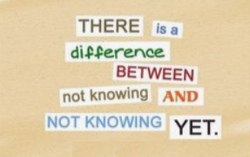
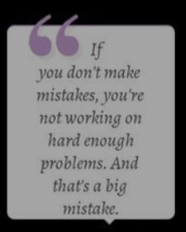
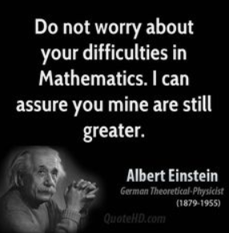
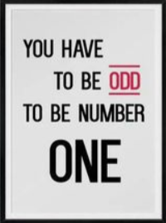
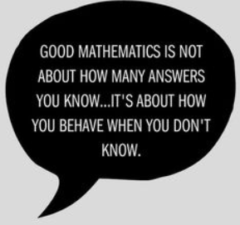
Maths Quotes

