Slide 1
Why Study French?

Slide 2
Question:
I don’t want to be a translator or a teacher, so I don’t really need to take a language, do I?
Answer:
There are so many other jobs where French is useful, not just teaching and translating!

Slide 3
You don’t need to specialise in a language in order to continue with them after GCSE; you could enter the world of work, volunteer, travel abroad or study at college or sixth form.
Learning a language is a lifelong skill.

Slide 4
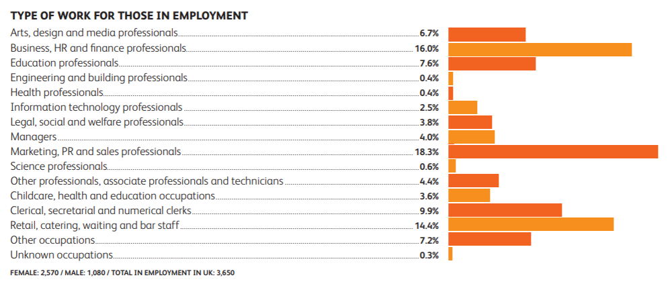
These are the career destinations of recent language graduates.
Only 7.6% work in the education sector.
Source: HESCU (2018)

Slide 5
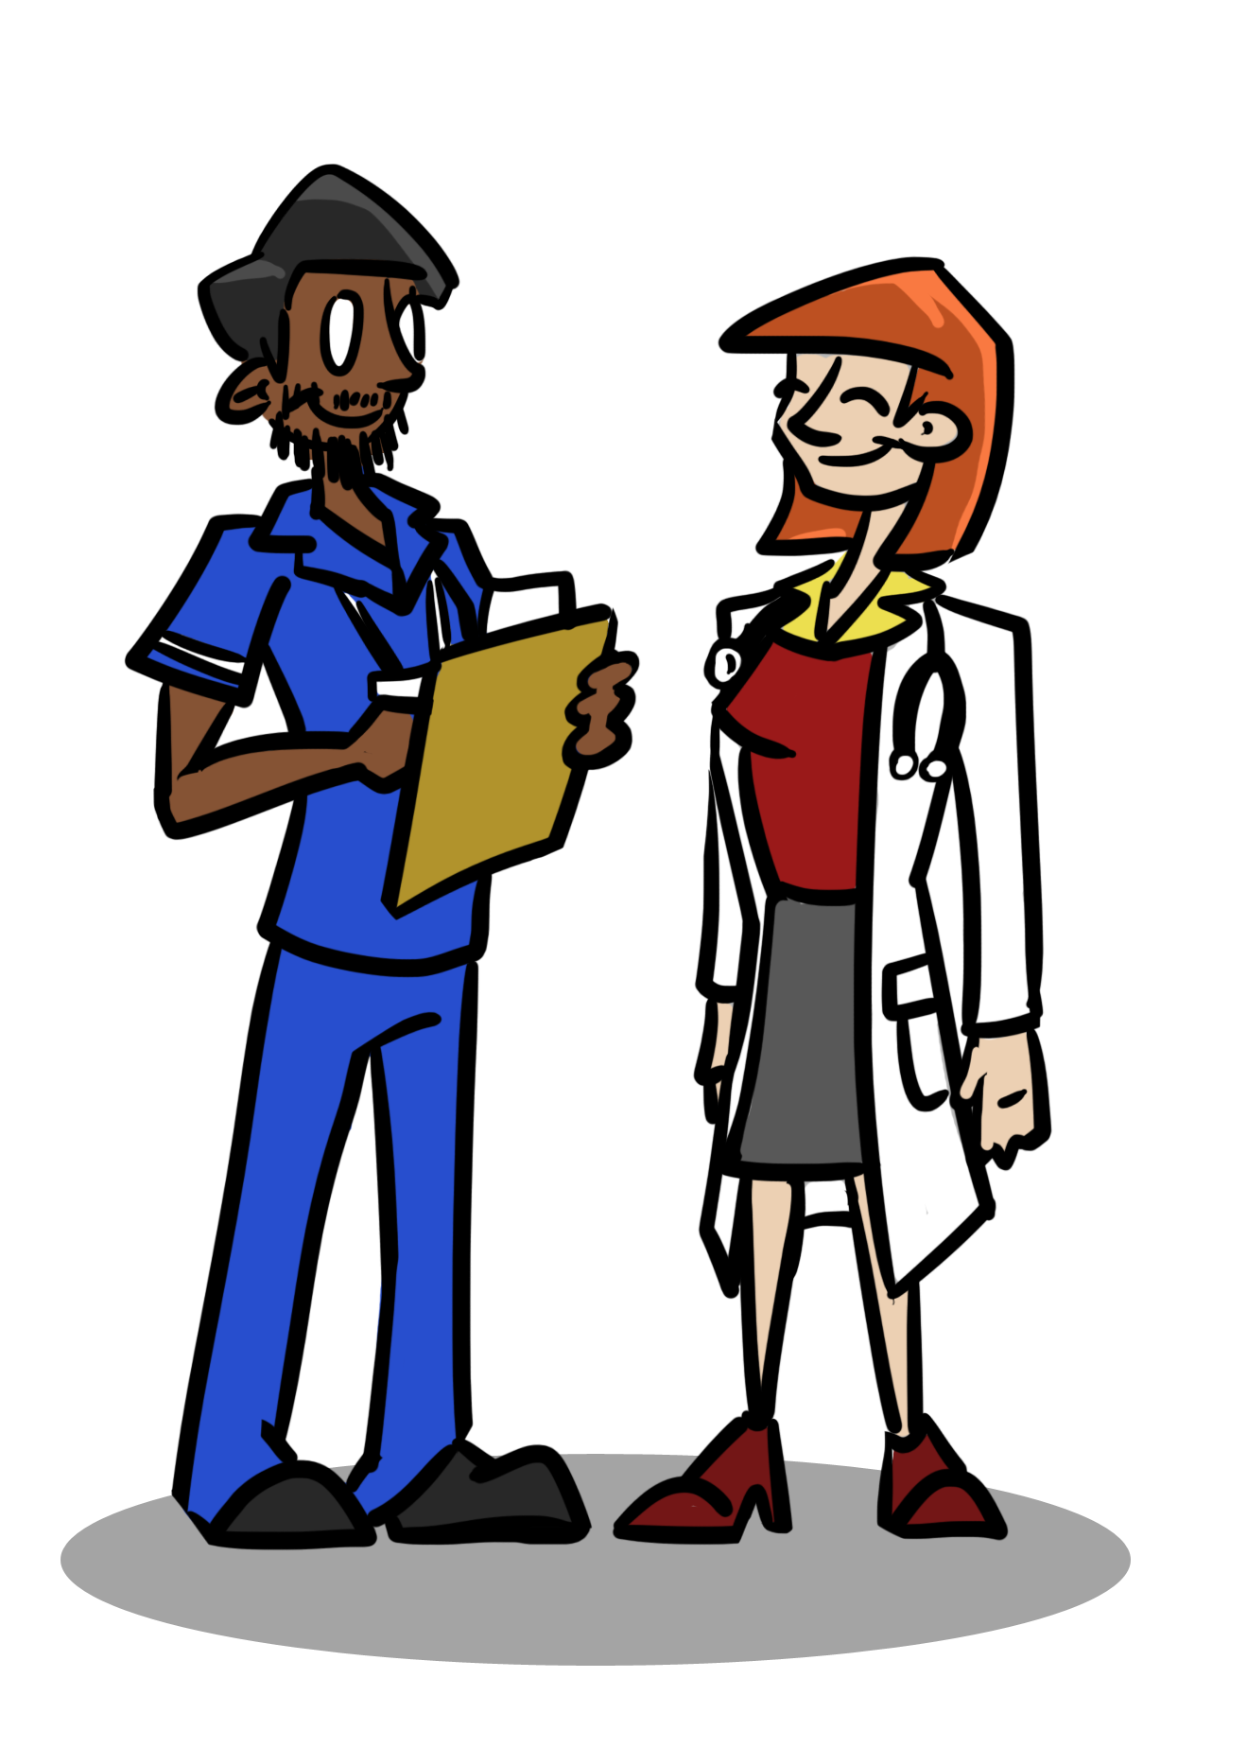
If you want to go into medicine or law, you will come across many Latin terms. Your knowledge of French will really help you to understand what these terms mean.

Slide 6
Taking French will help you to keep your options open.

Slide 7
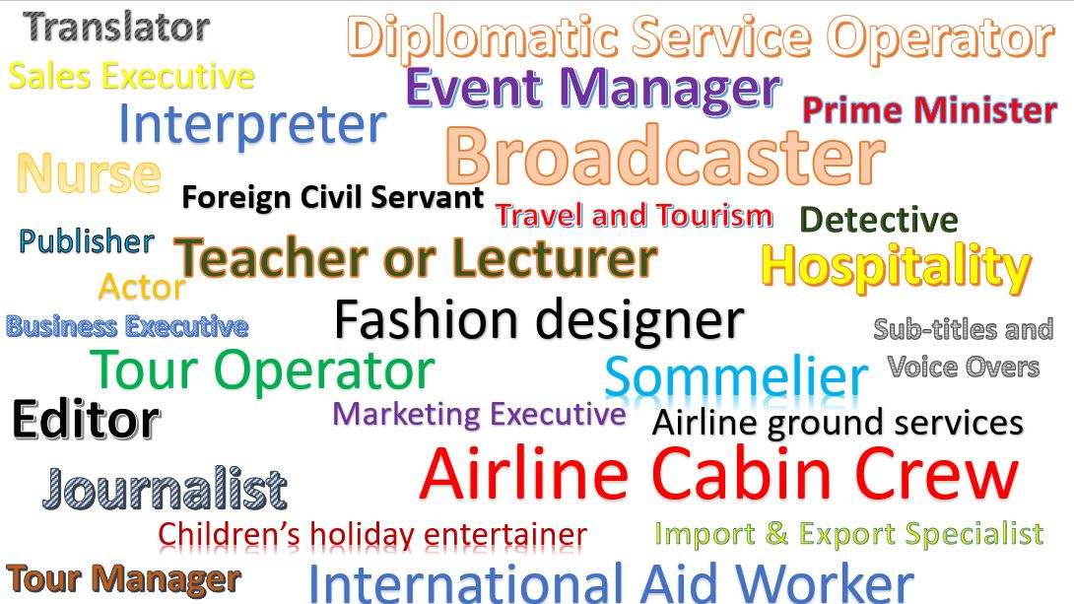
There are so many jobs available to you if you speak French. Here are a few. Can you think of any more?

Slide 8
C’est quel job?
agriculteur
serveur
professeur
vendeur
avocat
plombier
pompier
informaticien
chauffeur
cuisinier
ingénieur
juriste
photographe
vétérinaire
secrétaire

Slide 9
In fact, some of the jobs you might do in the future, haven’t been invented yet!

Slide 10
Have a look at this jobs website to see which jobs you can apply for if you know French.
https://www.multilingualvacancies.com/

Slide 11
Functional v Fluent
One of the problems with learning a language is that it can take a long time to become highly proficient. As you know, learning French takes a lot of practice - especially with speaking skills!
Knowing a little bit of language - enough to ‘get by’- can be extremely useful.
Learning 1000 words can help us to feel able to communicate and feel more confident when using a foreign language.

Slide 12
Did you know that … ?
French is spoken on all continents
It is spoken on and under water
It is spoken in space … and in cyberspace

Slide 13
Can you think of examples where this is true?
French is spoken on all continents
It is spoken on and under water
It is spoken in space … and in cyberspace

Slide 14
French is considered by many to be the language of culture: fashion, art, music, cinema, literature and fine cuisine. When you learn French, you open the door to all of these things, as well as thinking about your career … … and it’s a good idea to keep the door open.

Slide 15
You do have to think hard when you learn a language.

Slide 16
Research shows that learning a language really helps you in other subject areas.

Slide 17
In fact, scientific studies tell us that learning a language is really good for our brains.

Slide 18
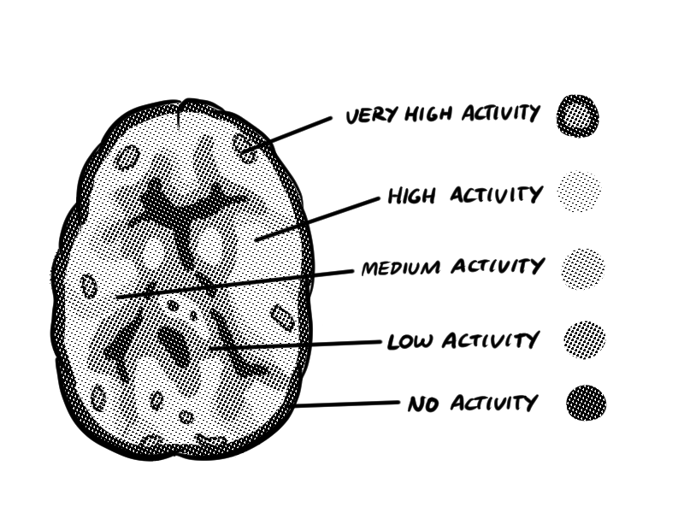
A recent study showed that language learning has a visible effect on the brain. Parts of the brain grow as a result of learning a language!

Slide 19
Learning French really helps you to improve your memory. Multiple language speakers are better at remembering lists or sequences and patterns.

Slide 20
The benefits of a bilingual brain
Watch this short TED-ed video about how knowing another language has real benefits for your brain.
The benefits of a bilingual brain

Slide 21
You might already know about the LORIC attributes.
Leadership Organisation Resilience Initiative Communication

Slide 22
Can you think of up to three ways in which learning French can help you to develop these skills?
Leadership (la direction)
1 …………………………………….………………………….………
2 …………………………………….………………………….………
3 …………………………………….………………………….………
Organisation (l’organisation)
1 …………………………………….………………………….………
2 …………………………………….………………………….………
3 …………………………………….………………………….………
Resilience (la tenacité)
1 …………………………………….………………………….………
2 …………………………………….………………………….………
3 …………………………………….………………………….………
Initiative (l‘initiative)
1 …………………………………….………………………….………
2 …………………………………….………………………….………
3 …………………………………….………………………….………
Communication (la communication)
1 …………………………………….………………………….………
2 …………………………………….………………………….………
3 …………………………………….………………………….………

Slide 23
All of these characteristics not only develop us as human beings, but they are also valuable skills which employers look for when hiring staff.
Learning French helps us to:
Respect others
Develop empathy
See difference as a positive
Accept diversity
Develop relationships
Have an ‘open’ character.
Can you add to the list?

Slide 24
Learning French …
Brings travel opportunities
Increases employment prospects
Connects cultures and breaks down barriers of communication and understanding
Celebrates differences and similarities between cultures
Boosts the economy and the UK export industry
Promotes tolerance
Widens horizons
Helps shape a more broad-minded, outward-looking society
Can you explain why?

Slide 25
You already know thousands of French words. Here are some examples.
table
visible
comfortable
information
attention
communication
chic
couture
silhouette
stable
entrepreneur
chauffeur
royal
adorable
transformation
bouquet
boutique
parent
petite
different
animal
café
façade
train
Apparently, we already know around 15,000 without studying French.

Slide 26
When you study French, you make learning another language so much easier.
French is from a family of languages called the ‘romance’ languages. So, learning other languages from this family (like Spanish, Italian, Portuguese, Romanian) is easier, as the vocabulary and grammar rules are similar.
All of these languages developed from Vulgar Latin!

Slide 27
Languages allow you to compete in a global jobs market.
Three quarters of employers say that they need their employees to have some foreign language skills.
Why might employers want you to have these skills?

Slide 28
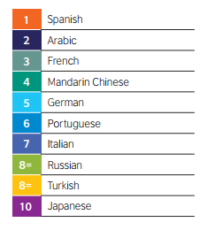
Prosperity Security Influence
A recent British Council study identified a list of ten languages which will be of crucial importance for the UK’s prosperity, security and influence in the world in the years ahead.
https://www.britishcouncil.org/sites/default/files/languages-for-the-future-report.pdf

Slide 29
32,000,000 reasons to learn a language
Even if you don’t think you will ever travel abroad, there are around 32 million foreign visitors to Britain every year.
There are so many different types of jobs which involve attracting these visitors and a little language ability goes a long way.
There is no better time to keep developing your language skills as they will be a great asset to you in many aspects of your future life.

