Slide 1
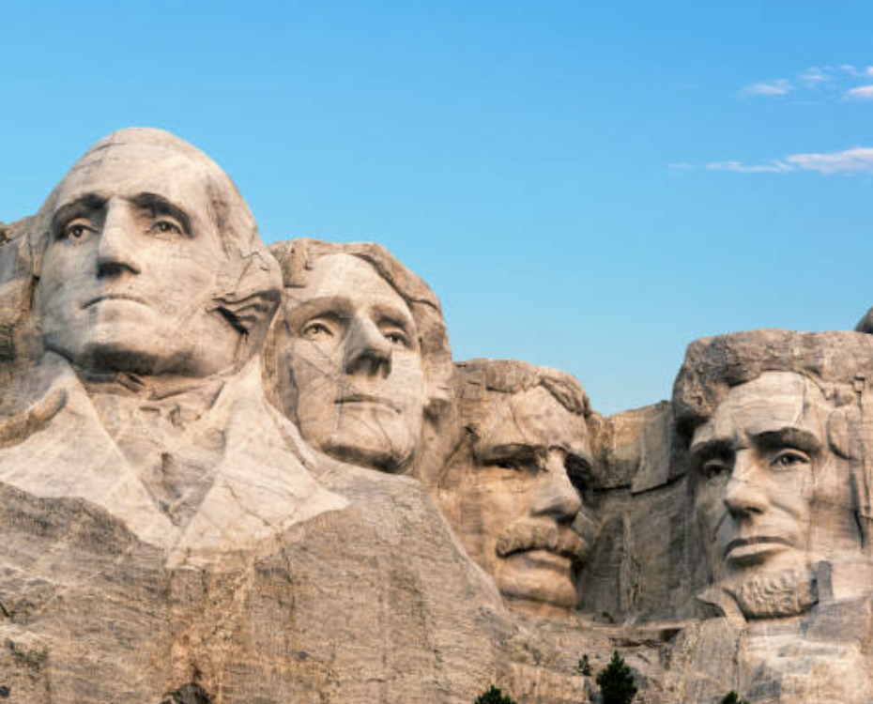
Why does History matter?

Slide 2
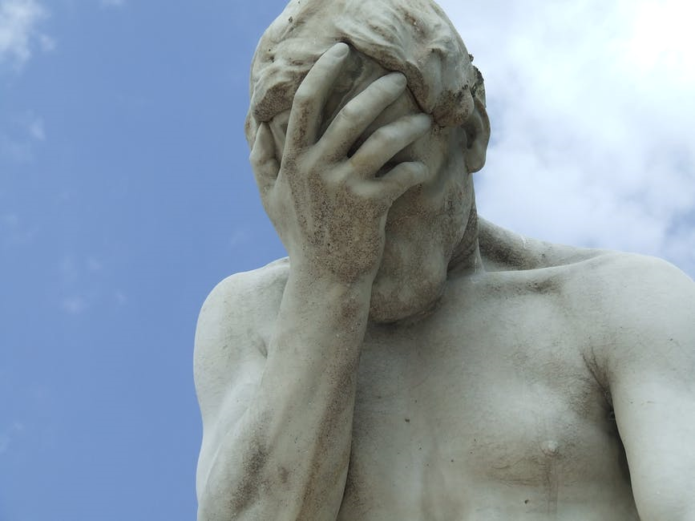
Why does History matter?
It’s hard to know where to begin with this question.
Many students make the mistake of thinking History is not important.
As a result they miss out on one of the most rewarding, interesting and enjoyable GCSEs available.
If you speak to some adults you know, many of them will often remark that they wished they’d tried harder at History in school as they’ve found themselves more interested in their adult life.
Don’t become one of those adults.
Embrace History now!
Notes:
Image – https://www.pexels.com/photo/male-statue-decor-931317/

Slide 3
Sorry – but I just don’t see why History matters to me and I can think of five reasons why.
1
It’s over, it happened and it won’t happen again!
5
I just don’t find anything from History remotely interesting.
4
2
3
Unlike Maths and English it doesn’t offer me anything I’ll ever need in the future.
All you can do with it is become a History teacher.
It’s just not relevant to the life I’m living now or will live in the future.
None of these are valid reasons and this is why not...
Notes:
Photo - https://www.pexels.com/photo/male-statue-decor-931317/

Slide 4
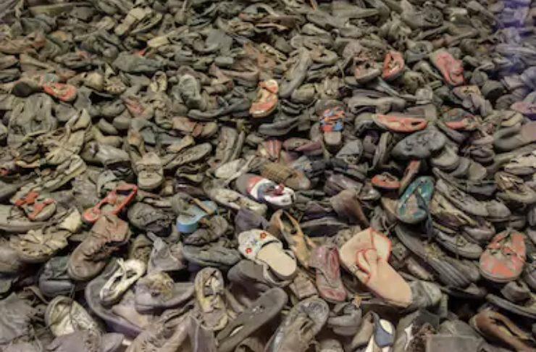
1. It’s over, it happened and it won’t happen again!
Not true… History repeats itself all of the time!
In 1945 it was discovered six million people had been murdered by a government because of their race, religion, sexuality and beliefs.
This became known as Genocide.
This example was called the Holocaust.
Despite a belief it would never happen again there has been genocide across the world in places such as:
Cambodia, Asia (1972)
Guatemala, America (1981-1983)
Bosnia, Europe (1992-1995)
Rwanda, Africa (1994)

Slide 5
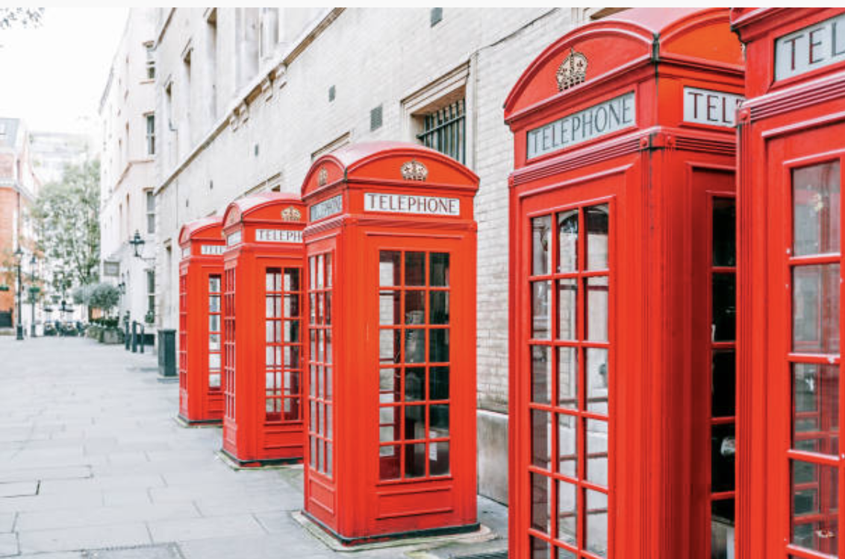
1. It’s over, it happened and it won’t happen again!
Human Progress
Past Mistakes
Future Development
It is vital to know our History to spot when it inevitably reoccurs.
Only by doing this will society continue to develop and go forward.

Slide 6
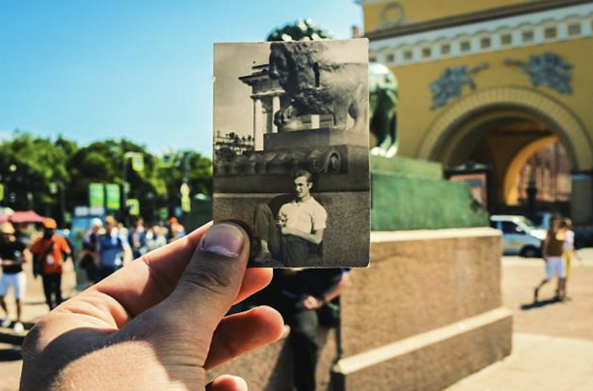
2. Unlike Maths and English it doesn’t offer me
anything I’ll ever need in the future
History is a lot of work.
But that means those with History qualifications have achieved lots of skills through one subject.
No other subject will support your literacy and English as much as History does.
The skills required for all History qualifications can be used in other subjects as well.
You WILL develop these as part of your History course.

Slide 7
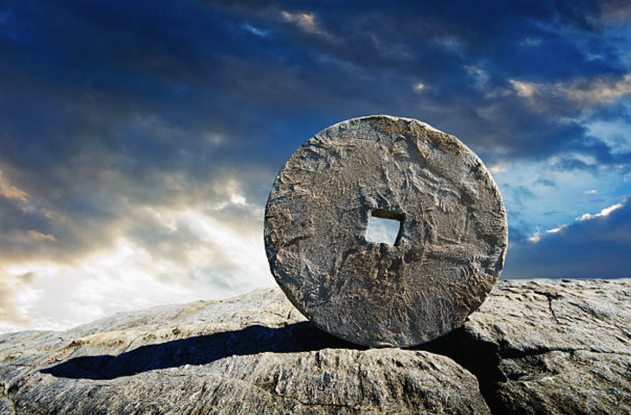
2. Unlike Maths and English it doesn’t offer me
anything I’ll ever need in the future
Cross-curricular Skills
English
Drama (scripts)
Science
PSHCE
Maths
Psychology
Sociology

Slide 8
2. Unlike Maths and English it doesn’t offer me
anything I’ll ever need in the future
Not everything is about qualifications and subjects however.
These skills will also make you a better person.
Being able to do these things will make you:
More confident
A better communicator
A more opinionated person
A better leader
And these characteristics will bring you future success, happiness and well-being!

Slide 9
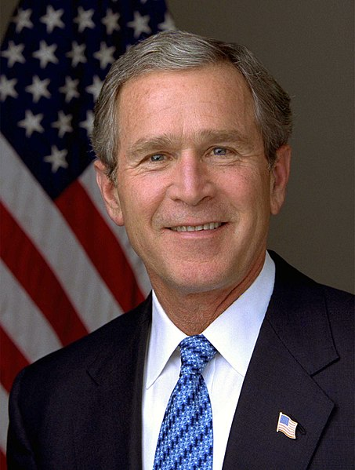
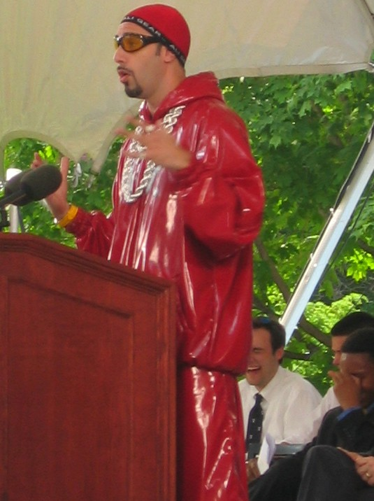
3. All you can do with it is become a History Teacher!
It is true most History graduates go into teaching or further education.
But it doesn’t mean it’s all you can do.
People in a range of professions have studied History.
George W Bush
Former President of the USA
Kate Middleton Duchess of Cambridge
Sacha Baron Cohen Comedian and Actor

Slide 10
3. All you can do with it is become a History Teacher!
Historical Skills
Journalism
Museum Curator/ Tour Guide
Police
Politician
Historical Props and Set Advisor (Media)
Solicitor
Judge
As well as giving you lots of personal skills, it also gives you lots of transferable skills which employers want you to have.
Have another look at the key skills diagram from the earlier slide.
Now look at which professions desire those skills….

Slide 11
4. It’s just not relevant to the life I’m living now or will live in the future
It’s fair to say some History may feel irrelevant to you.
But to say nothing is relevant just isn’t true.
Don’t you ever wonder why there is conflict in the world today?
Do you honestly believe you have no family connections to major events?

Slide 12
4. It’s just not relevant to the life I’m living now or will live in the future
History repeats itself a lot so it might not be relevant to you today, but who knows what will happen or happen again tomorrow?
You’d also be surprised how much of what we do today is inspired by what has happened previously.

Slide 13
Non-European countries that speak European languages used to be part of an Empire. E.g. Brazil was part of Portugal’s Empire.
Did you know?…
The term ‘prime minister’ was originally an insult. It was used by MPs to tease Robert Walpole who was the King’s favourite minister.

Slide 14
About 80% of the words in English are borrowed from other languages due to historical events. For example most French words are a result of the Norman invasion in 1066.
Did you know?…
Every year the Christmas Tree in Trafalgar Square is sent from Norway by their government as a thank you for British support in WWII.

Slide 15
5. I just don’t find anything from History remotely interesting
This is like saying ‘I don’t read because no books are interesting.’
And just like finding the right book is important for enjoying reading, finding the right topic is important for enjoying History.
Everything in the world has a History.
Whilst there are requirements for what you can take at GCSE, there is a range of topics and there will be something you like.

Slide 16
History is diverse and interesting….
Have an interest in Sports
Study Nazi Germany
Learn about how the 1936 Olympics was exploited by Hitler.
Have an interest in Medicine
Study The Ancient Greeks
Learn about Hippocrates and how doctors today swear a Hippocratic oath to their patients, like the Ancient Greeks.
Have an interest in Technology
Study The Second World War
Learn about how one of the earliest computers (the Colossus) was developed in Britain as part of a code-breaking mission during WWII

Slide 17
Why does History matter?
As you can see, the usual claims about why History doesn’t matter can all be countered.
Therefore surely the conclusion is that History really does matter.
History can do many things for you.
We’ve discussed most of them but just to remind you here’s a quick summary…

Slide 18
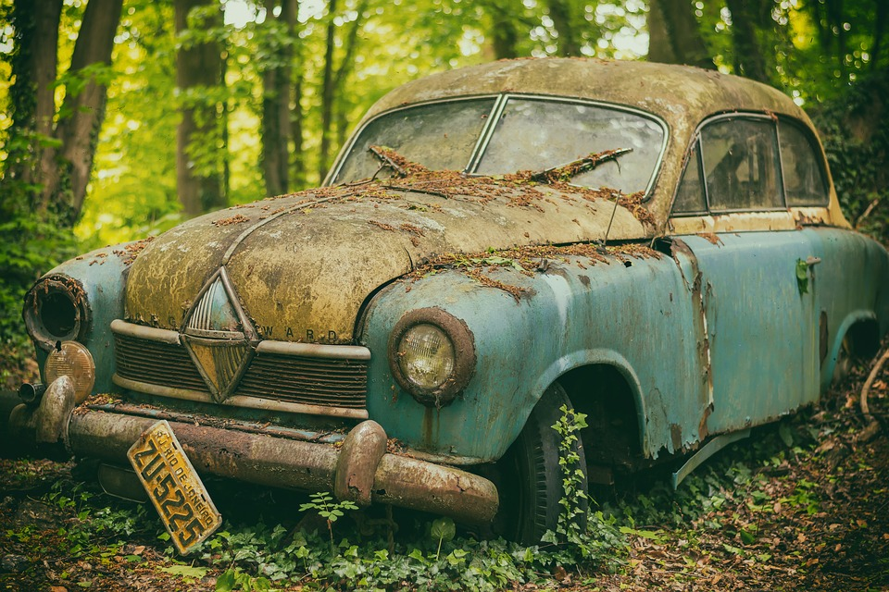
Why does History m atter?
1
History repeats itself, by knowing the past we can’t prevent bad things in the future but we can try to shape it more positively.
2
3
History links to many other subjects. It’s a great way of improving your English as well as many other subjects.
History embeds so many transferable skills that a range of employers want to see. So you actually open options rather than close them with History.

Slide 19
Why does History matter?
5
I just don’t find anything from history remotely interesting… YET! History is like reading, there is something for everyone. You’ll only find it by trying it!
4
The world we live in today has been shaped by History. There is no getting away from the past in the present, and that will continue into the future.

Slide 20
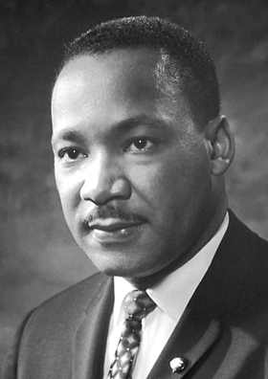
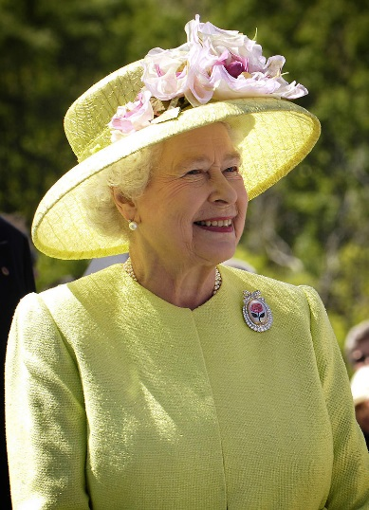
And if you won’t take my word for it… take theirs…
We are not makers of History, we are made by History!
Martin Luther King
The upward course of a nation's history is due in the long run to the soundness of heart of its average men and women.
Queen Elizabeth II
History shall be kind to me, for I intend to write it!
Winston Churchill
Notes:
MLK - https://upload.wikimedia.org/wikipedia/commons/0/05/Martin_Luther_King%2C_Jr..jpg
Elizabeth II - https://en.wikipedia.org/wiki/Elizabeth_II#/media/File:Elizabeth_II_greets_NASA_GSFC_employees,_May_8,_2007_edit.jpg

Slide 21
History and Careers
Historian, Print Journalist, Politician (many Prime Ministers and American Presidents Studied History), Writer, Editor, Actor/Comedian, Curator, Art Historian, Lawyer –Barrister or Solicitor, Teacher, Academic, Civil Servant, Accountant, Owning a business, Archaeologist, Anthropologist, Advertising, Marketing, Working in Museums, Research, Archivist, Broadcast Journalist, Restoration work –e.g. listed buildings and planning, Costume History and Design, Working in heritage organisations and conservation and many more…
History is useful in so many different careers. The ability to analyse, evaluate, communicate ideas well, create arguments, use evidence effectively, make cogent judgements and use and develop persuasive arguments are vital in many career fields. Opposite are just a few ideas of the different careers where your study of HISTORY will come in handy.

Slide 22
For more information, use these links:
Information on careers in History:
https://icould.com/explore/subject/history
Watch a video on someone using History in their career:
https://www.careersbox.co.uk/blog/

