Slide 1
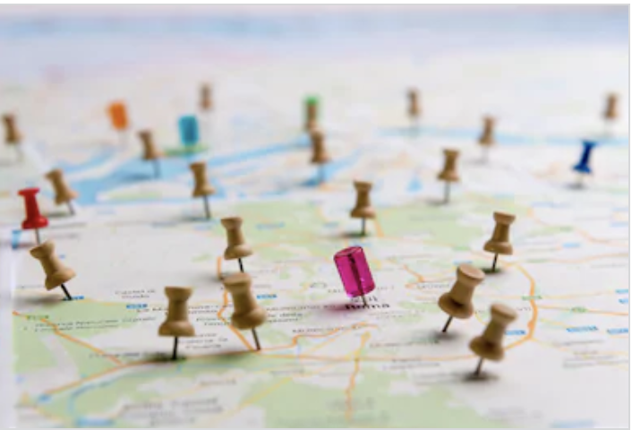
Why Study Geography?
Global Village and looking to GCSE

Slide 2
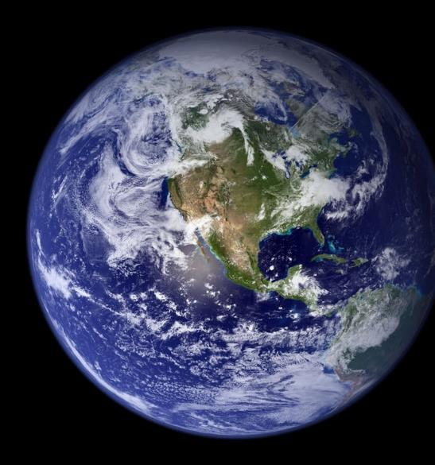
Geography - bringing you closer together
Within 1 minute you could find what's going on in the world!
Give it a go… come up with five stories from around the world!
Social Media on your phones allows you to see what's happening 24 hours 7 days a week
That also makes you contactable at all times too! Not always a good thing!

Slide 3
Global Village
The idea that the whole world is connected.
It allows people to know about the issues and events in other countries throughout the world!
Due to growing technology… the world is getting smaller

Slide 4
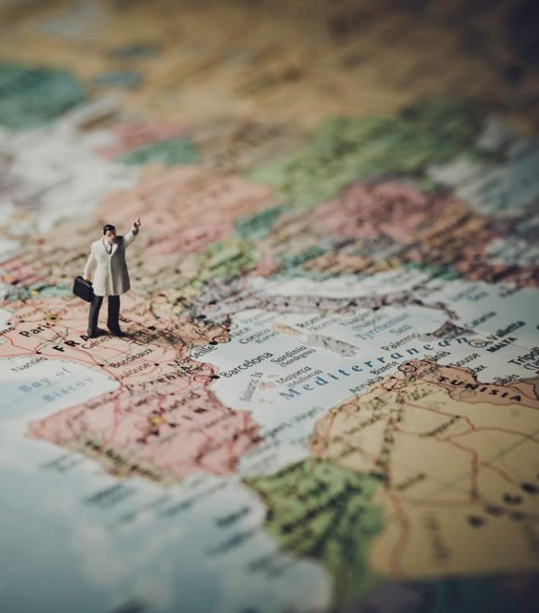
Where will Geography take you?
“The study of Geography is about more than just memorizing places on a map. It’s about understanding the complexity of our world, appreciating the diversity of cultures that exists across continents. And in the end, it’s about using all that knowledge to help bridge divides and bring people together.”
Barack Obama

Slide 5
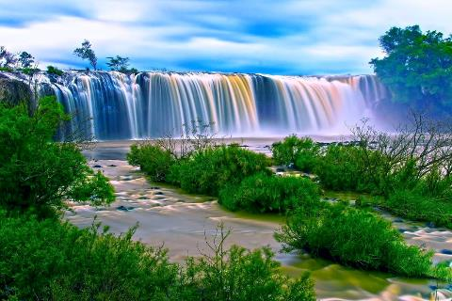
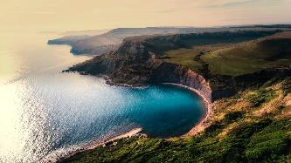
Why Geography is essential
You get to learn about physical systems that affect everyday life (e.g. water cycles, climate change, coastal erosion)
Resilience

Slide 6
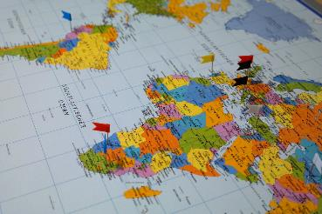
Why Geography is essential
Learning the location of places and the characteristics of those places in order to function more effectively in our increasingly interdependent world
Independence

Slide 7
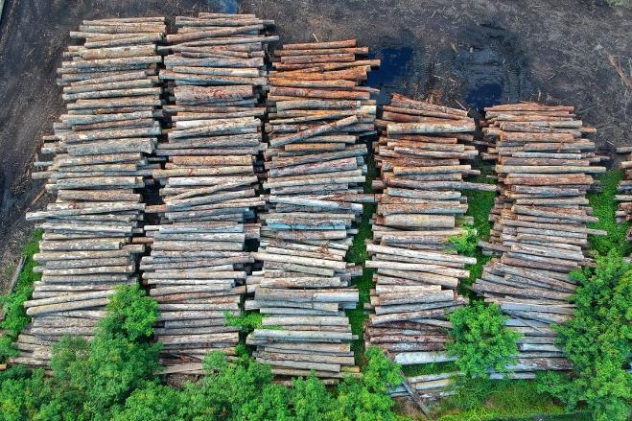
Why Geography is essential
You will be able to make sensible judgements about matters involving relationships between the physical environment and society
Initiative

Slide 8
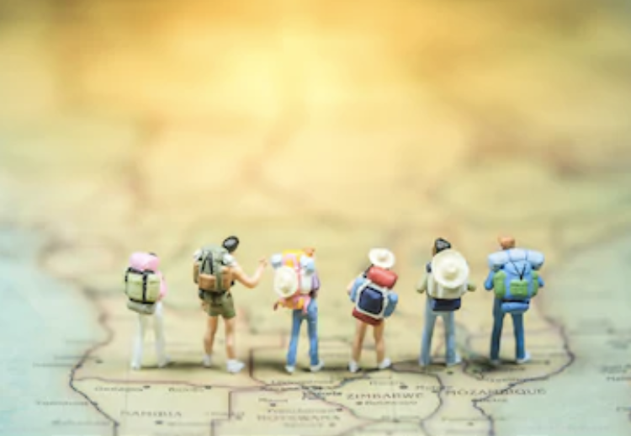
Why Geography is essential
To understand global interdependence and to become a better global citizen
Communication

Slide 9
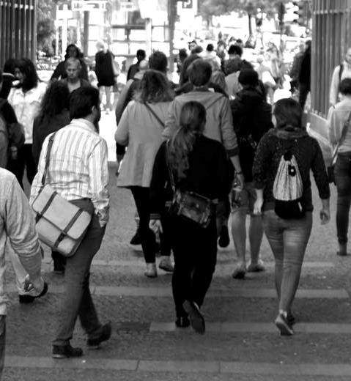
Why Geography is essential
You will recognise spatial distributions at all scales – local and worldwide – in order to understand the complex connectivity of people and places
Leadership

Slide 10
Why Geography is essential
Get to grips with practical skills such as using GIS, interpreting photos, map reading, presenting and also debating topical issues
Debate and
reasoning

Slide 11
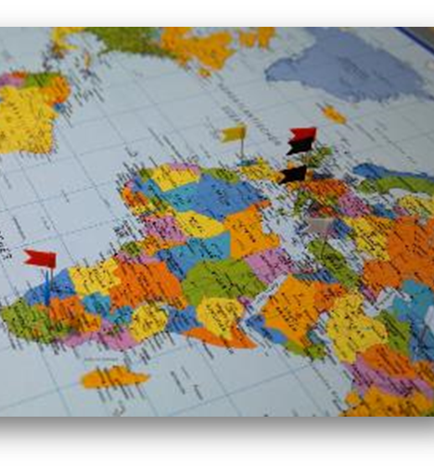
Common misconceptions
Geography is not just about rivers and coasts.
Geography is not just countries and cities.
Geography is not just for weather forecasters and geography teachers.
There is so much more…

Slide 12
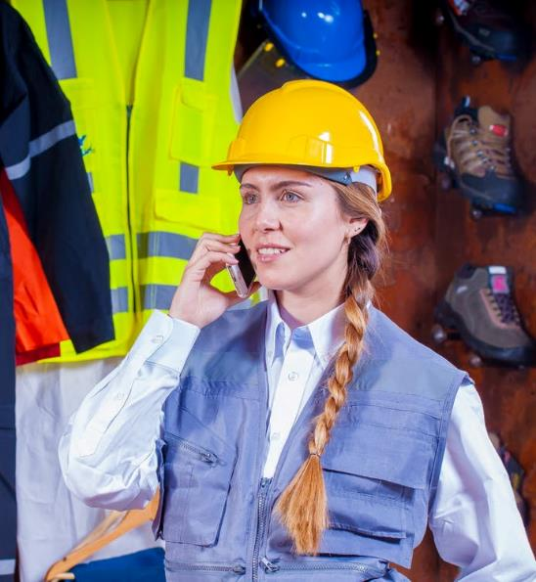
Careers and futures
Geography is one of the most employable subjects in the UK - 90% of graduates in 6 months have jobs. That’s in the top 6 of the country!
Geographers are seen as employable due to their combination of transferrable skills including problem-solving and critical thinking.
Skills learnt in Geography are used in a number of different jobs - not just the careers that are explicitly geographical.
EXAMPLE SKILL
Statistical analysis can be many jobs - Banking, trading, website design, retail manger, project design, sports promoter and many more!

Slide 13
TASK:
List down as many jobs as you can that Geography could support with

Slide 14
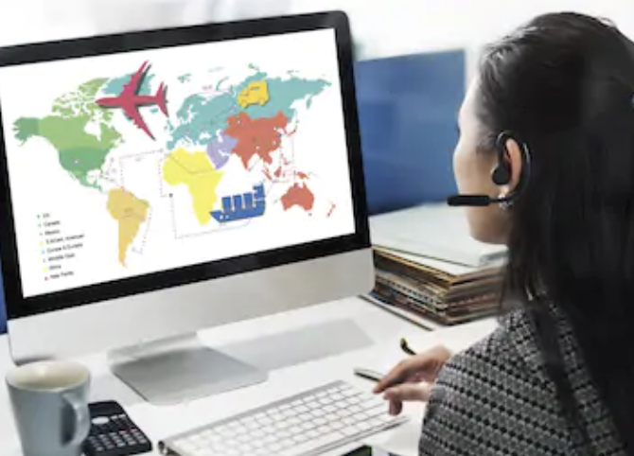
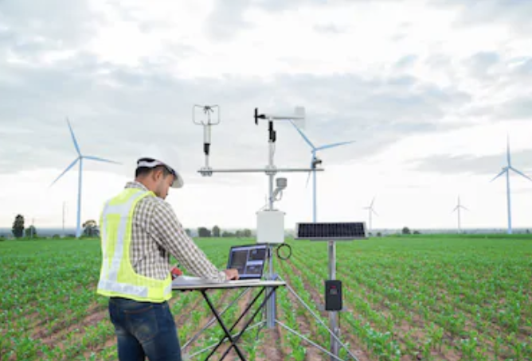
Jobs for geographers
Transport Planner (such as working for TFL)
Teacher
Travel Agent
Flood Risk Coordinator
Urban Regeneration and Town Planner
Working for an energy supplier
Armed Forces

Slide 15
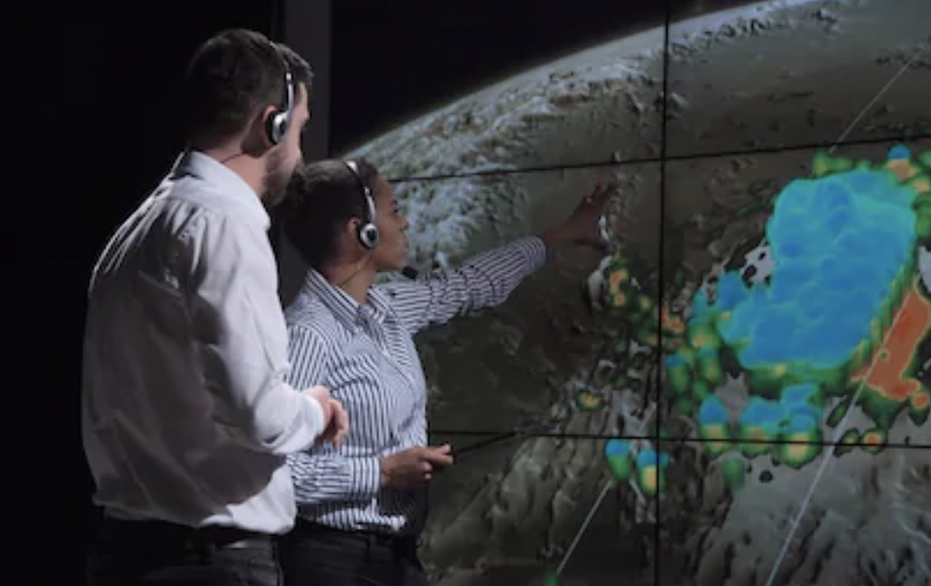
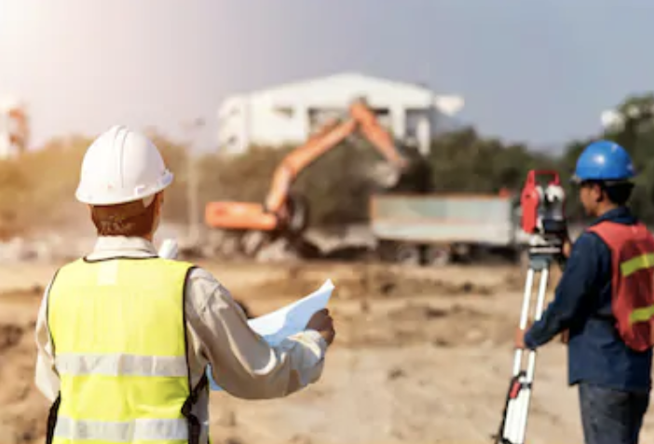
Jobs for geographers
Meteorologist
Hazard and Crisis Manager
Journalism
Humanitarian
Landscape Architects
Surveyors
Environmental Campaigner
Civil Servant

Slide 16
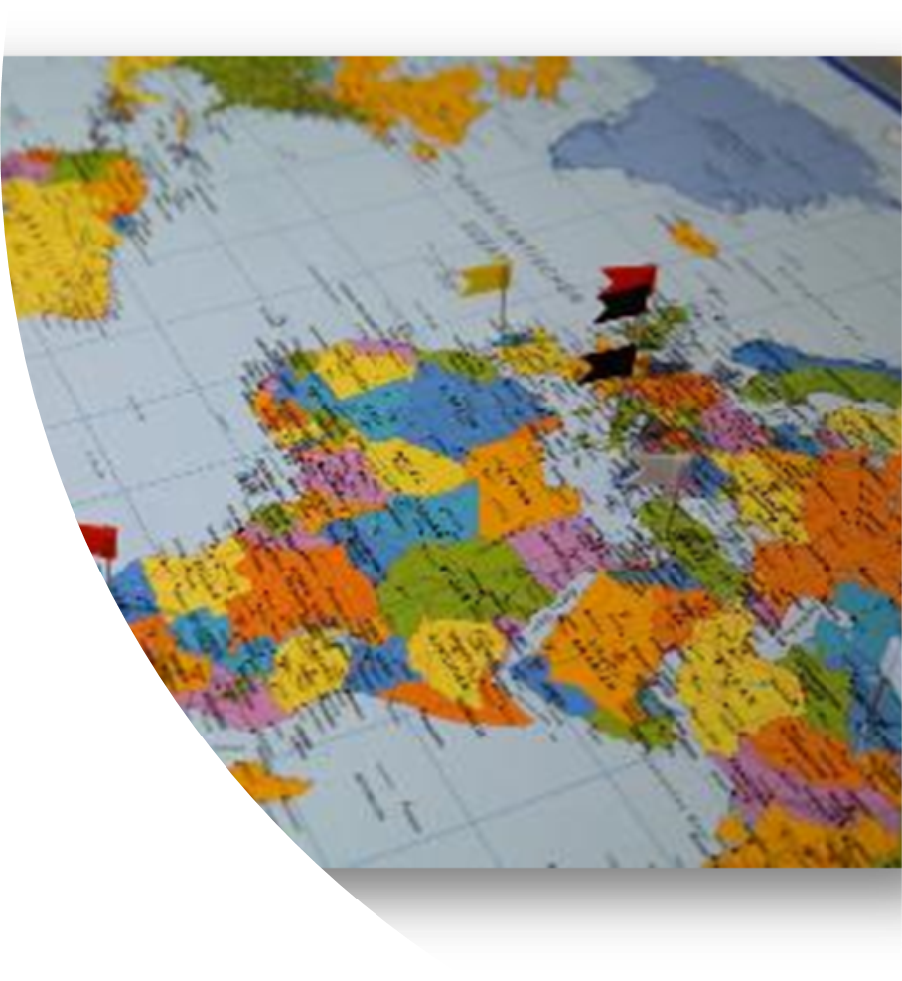
Finding out more about studying Geography
Why continue to study Geography? https://www.rgs.org/geography/studying-geography-and-careers/
The importance of studying Geography https://www.rgs.org/geography/studying-geography-and-careers/geography-at-university/why-study-geography/
https://www.thecompleteuniversityguide.co.uk/courses/geography-environmental-science/six-reasons-to-study-geography-environmental-science/

