Slide 1
Drama: Year 9
Why Study Drama?

Slide 2
Drama: Year 9
“Some experiences are so precious and difficult to nurture, they should be treated as endangered curriculum species.”

Slide 3
Common misconceptions
“Drama is for show-offs. I’m not confident enough.”
“Drama is not going to help me to get a job after school.”
“It’s just for people who want to be actors.”
“A GCSE in Drama isn’t really worth anything.”
“Drama is for non-academics. I need to concentrate on more academic subjects for the career I have in mind.”

Slide 4
“Drama is not going to help me to get a job after school.”
Studying Drama will help you to develop a large number of transferable skills highly valued by employers.

Slide 5
Working with a partner, list the different skills which you regularly use in your Drama lessons.
You have 5 minutes.

Slide 6
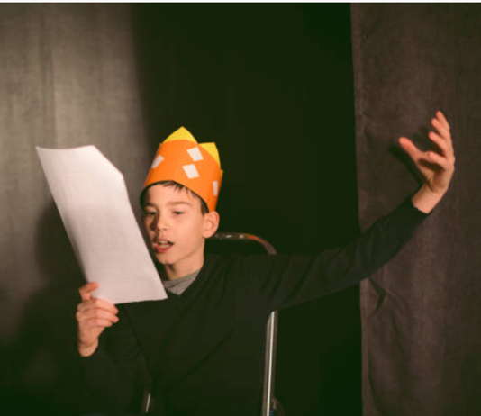
Skills used in Drama…
Ability to speak/express yourself confidently in front of a group.
Ability to work as part of a team, offering ideas and listening to others.
Ability to lead a team.
Ability to work independently with self-discipline.
Ability to empathise with others and their situation by taking on different roles.
Ability to use initiative, improvise and think creatively.
Physical co-ordination.

Slide 7
Skills used in Drama…
Communication skills.
Presentation skills.
Organisation skills.
Research skills
Line/text-learning skills
Ability to negotiate.
Ability to analyse/evaluate.

Slide 8
Going back to your partner … How many jobs/careers can you think of where any of these skills would be particularly useful?

Slide 9
“Drama is for show-offs. I’m not confident enough.”
If you lack confidence, then Drama is the perfect way to build your confidence. Drama develops skills such as listening, reacting and responding. It is not always about being in the spotlight.

Slide 10
“It’s just for people who want to be actors.”
Most specifications offer opportunities for students to develop technical skills, such as lighting or sound, and design skills, such as set or costume design.

Slide 11
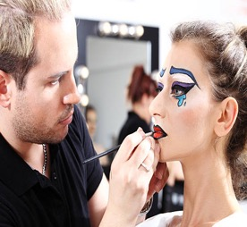
Of course, many people who study Drama at school do go on to careers which are theatre/drama related.
TASK: List the number of jobs/careers you can think of (other than acting) which are directly related to theatre or Drama.

Slide 12
Careers Drama supports with
Directing
Choreography
Lighting Design/Operation
Set Design
Stage Management
Theatre Management
Theatre-in-education

Slide 13
Careers Drama supports with
Costume/Make-up
Drama Teaching
Marketing/Publicity
Box Office
Film/TV
Writing for film/theatre
Musicians/Dancers

Slide 14
“A GCSE in Drama isn’t really worth anything.”
GCSE and A level Drama qualifications are recognised by all major universities in exactly the same way as any other GCSE or A level qualification.

Slide 15
“Drama is for non-academics. I need to concentrate on more academic subjects for the career I have in mind.”
Drama is for all abilities. All Drama specifications now include a rigorous written paper as part of the course.
Drama can also complement other GCSE courses, in particular, English Literature as it can give a different ‘angle’ on how to approach a text.

Slide 16
If you already have a heavily academic programme of options, it is important to have some creative outlet during the week – an opportunity to express yourself whether that is through Art, Music, Drama or another creative or practical subject.

