Slide 1
Why Business Studies?

Slide 2
‘The way to get started is to quit talking and begin doing’
Walt Disney
Something different…

Slide 3
How will this help our students?
The purpose of this document is to support students in making an informed choice surrounding the option choice of GCSE Business.

Slide 4
How will this help our students?
For some students, it is the opportunity to study something new and different; they may be able to choose a vocational option for Business at your school. For other students, it may be they have expressed a desire to engage with the subject due to a desire to start their own company, family motivators or just to be able to explain what is going on in the world around us.

Slide 5
How will this help our students?
Students will join from a variety of backgrounds and knowledge, the purpose of the course is to inspire and build leaders, entrepreneurs and the individuals who will continue to develop our globe.

Slide 6
PiXL Futures: Business Key Stage 4
According to OfQual, exam entries for GCSE Business students were 85,000 students, making it one of the most popular non E-Bacc subjects available in the UK curriculum
Source: https://assets.publishing.service.gov.uk/government/uploads/system/uploads/attachment_data/file/712450/Report_-_summer_2018_exam_entries_GCSEs_Level_1_2_AS_and_A_levels.pdf

Slide 7
Why study GCSE Business?
GCSE Business builds your skills of analysis, research, making judgements, presentation, teamwork and delegation. It is a subject with fully transferable skills!
The world around you is constantly changing. GCSE Business helps you understand why this is and how it can affect you, businesses and the country
Business is a subject you as a student can relate to: the moment you take an Insta, post on YouTube, download an app or play Fortnite….it’s all business.
Have you ever wondered what an entrepreneur is or does? Are you an entrepreneur? GCSE Business will help you unpick this.
Studying business helps you understand the wider world around you - as a student you can take these skills and knowledge anywhere in the world.

Slide 8
GCSE business is a course which develops your skills, character and culture

Slide 9
Why study GCSE Business: the skills
Decision Making: ability to make strong logical and informed decisions - this saves you time and hassle in your personal life as well!
Problem-solving: you will have to adapt to situations, change focus, think of logical solutions that work in the short and long term. A skill for life!
Presentation: from the way your work looks to presenting your projects to peers, presentation forms a key part of your course and sets you up for the boardroom!
Evaluation: the ability to form a judgement, which weighs up factors and considers the short term and long term impacts of a decision.
Leadership: from leading a group to leading your own learning, business is about showing the characteristics associated with leadership, can you achieve your end goal?

Slide 10
Why study Business: character building
GCSE Business & character
resilience
analytical skills
Appreciating different cultures

Slide 11
Why study Business: character building
Where do 'I' fit in a global society?
Ethics, morals and the environment: how can I make a difference?
Adaptable, flexible, creative

Slide 12
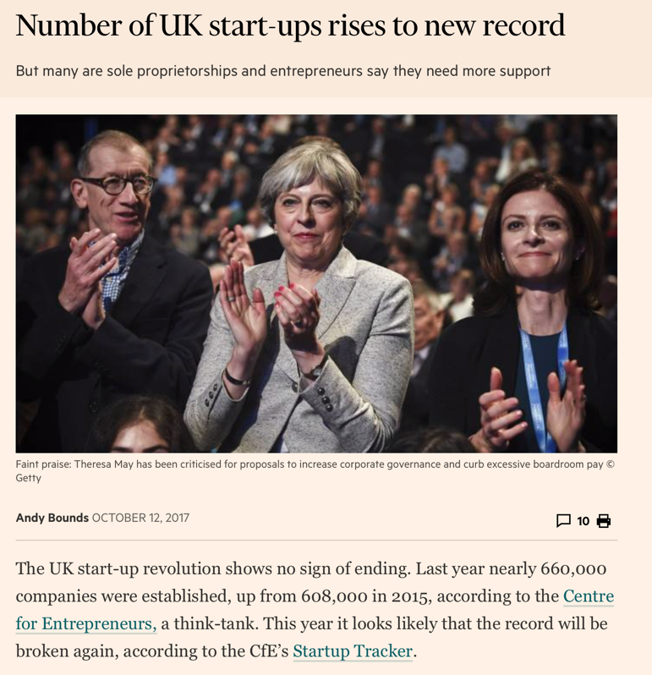
Did you know…
608,110 businesses were started in the UK in 2015
Jobs lead to more wealth, more funding, better education, welfare, hospitals, police and more!
New businesses create jobs for people, which fuels our economy

Slide 13
Misconceptions about Business Studies
Business is an easy subject!
Business is a hard subject with lots of writing!
The biggest misconceptions
Business is easy: those who have studied business will tell you it has a lot of challenges and because it is based on the real world, you need to stay up to date!
Business is hard: Business can be hard if you don’t put the effort in. This is the same for every subject. Business does not contain any more writing than similar subjects…

Slide 14
Case Study Task:
Business at the Festivals
think of a music festival or concert, something like Glastonbury or reading/Leeds festival.
where do you see business taking place at that festival?
2 MINS

Slide 15
Business at the Festivals
Food and drinks sellers
Merch’
Buying tickets online
Advertising the festival
Management of the stars
Management of the staff
Logistics of booking toilets!
Mobile phone recording the festival
Posting your stories on Insta
Texting your parents for more money!
Train/plane/car to get you home

Slide 16
Business at the Festivals
Your first homework is to find out how much money does a festival like Glastonbury make?
How could they make more?

Slide 17
Music and Business

Slide 18
DISCUSS: Have you ever considered a
career in the music industry using Business?

Slide 19
TASK: Leadership
What is meant by the term leadership?
In your opinion, which person you know of best defines the idea of leadership?
Why? What is it about them?

Slide 20
Watch this series of videos based on CEO secrets and what top CEOs knew before starting out
What can you learn from them?
Video links directly to YouTube. We recommend that you embed. Please see notes.
https://www.youtube.com/watch?v=OqXcTA1buvk
Notes:
https://www.youtube.com/watch?v=OqXcTA1buvk
Click the image for the video. We recommend that you embed to avoid ads and pop ups – we cannot do this due to our copyright restrictions.

Slide 21
Leadership in the real world
Leadership is one part of Business; it plays a significant role in the short and long term success of an organisation and an economy.

Slide 22
Leadership in the real world
Tim Cook had the unenviable task of taking over Apple from Steve Jobs. He has succeeded where many expected him to fail - Apple has grown even bigger than when Jobs was CEO.
How did Tim Cook achieve this?
BBC: https://www.bbc.com/news/av/technology-41590332/tim-cook-leadership-tips-from-apple-s-chief-executive
LifeHack: https://www.lifehack.org/articles/productivity/11-leadership-lessons-can-learn-from-tim-cook.html

Slide 23
TASK: Global challenges
Within your team, investigate some of today’s great leaders found in the world around us.
The leaders could be CEOs, politicians, humanitarians, public figures
What defines them as a leader?
What characteristics would you replicate in your leadership style?

Slide 24
A successful GCSE student
Within your teams consider the characteristics of what makes a successful Business GCSE Student.
You may wish to consider what the word ‘success’ means first.
Create a spider diagram with the key characteristics of a successful student. Do you possess these now? Would you like to possess them at the end of the course? How might these characteristics help you in your own ambitions and future careers?

Slide 25
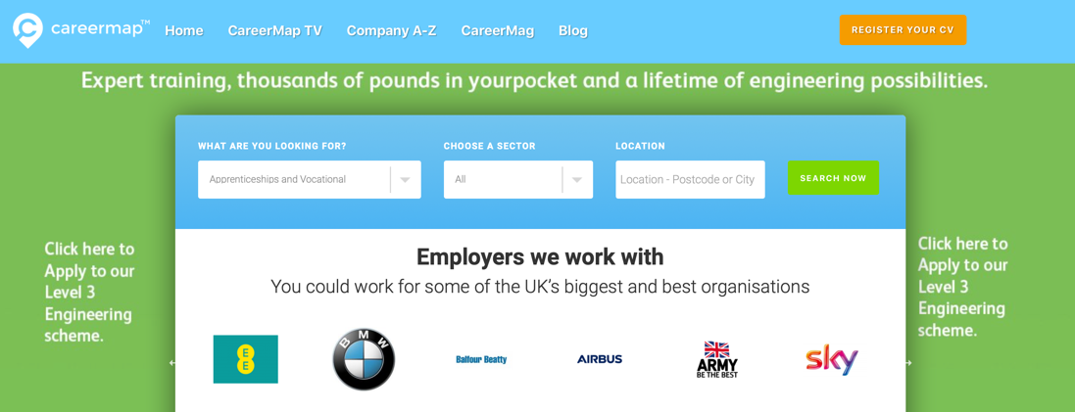
A career in Business
Consider the characteristics identified earlier.
Do these characteristics match up with the kind of career you are interested in?
What is it Businesses are really looking for? Just grades or more on top?
Utilise www.careermap.co.uk to investigate some companies and job roles which may appeal to you. What are they looking for?

Slide 26
Implementation in schools at KS4
Business is frequently a popular subject at KS4 due to being an ‘unknown’ quantity
Advertising
Year 9 Options evening: prepare a key question sheet; have existing KS4 students in place to help field questions; have activities for KS3 students to engage in, such as the logo game, cool wall of brands, business games on a PC, problem solving.
Year 9 Assembly: lead a 5/10 minute slot on entrepreneurship; ask someone to come in and speak about their business; run entrepreneur week, highlight the sheer variety of career options available, how Business fits within ethical/environmental beliefs and is a character building subject. Use examples of KS5 students and options chosen at KS5.
Year 9 ‘Taster sessions’: organise taster sessions based around an engaging topical theme; give students the opportunity to know and experience GCSE Business first hand; be realistic with expectations.
Further activities: ensure you are clear on entry requirements for the course; consider which specification is best for you and your cohort; is Vocational an option? (are you aware of the challenges/benefits?); ensure students know how Business GCSE can support options at A Level, including Economics and Business.
Is you subject organised on your VLE/system? Can Year 9 look at this in advance of the course? Have you used PiXL induction booklets?
Timetabling
Consider blocks available: how can Business facilitate, or be facilitated by other subjects?
Is Business in sufficient blocks/option choices for students?

