Slide 1
Why Study Art?

Slide 2
Common misconceptions around Art
“Your artwork has to be perfect”
“You have to know all the artists since the 1600s”
“I’ve heard that Artwork takes too much time”

Slide 3
Common misconceptions around Art
“You have to do loads of work to get marks in GCSE Art”
“Choosing GCSE Art means you won’t have any time for yourself and your friends”
“You need to know how to use all the different materials in the Art Department!”

Slide 4
Common misconceptions around Art
“Art GCSE won’t get you anywhere”
“Art is cool, but it’s not going towards a real career”
“Art isn’t for boys”
“You only choose Art GCSE if you are not clever”

Slide 5
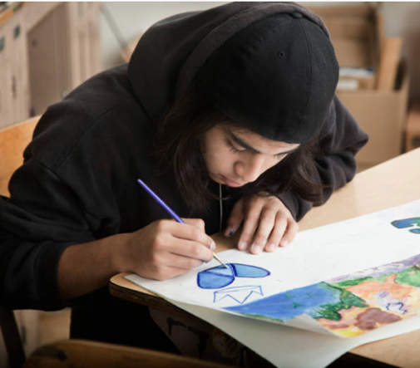
Common misconceptions around Art
Mum & dad say that “Art” will not get me anywhere and
I need to focus
on ‘core’ subjects only!

Slide 6
Why study Art?
Understand the world around you.
To express yourself.
Helps you think outside of the box.
You learn how to problem solve.
Not be scared of failure – experiment!

Slide 7
Why study Art?
Therapeutic - Art makes you happy.
Fastest growing industry in the UK.
One of the few GCSE subjects left with a large amount of practical coursework towards your final grade.

Slide 8
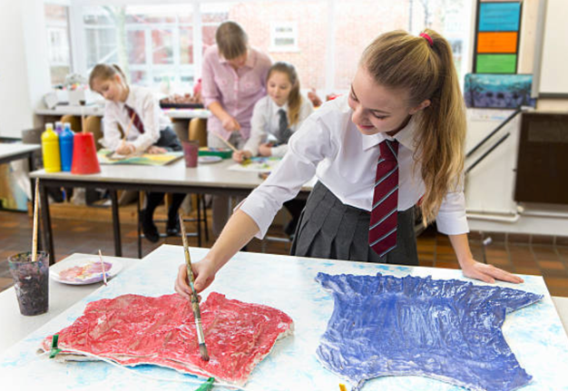
Why study Art?
“I learnt to do things I never thought
I’d be able to do, it was so fun and
I can’t wait to do it for A-Level!”

Slide 9
Video: Why Study Art?
Listen and watch what Creative practitioners have to say about Art in this video by Tate:
https://youtu.be/vKjkx6PzajE

Slide 10
TASK: How can Art develop your character?

Slide 11
Skills Art & Design gives you…
Explore a personal interest in WHY Art matters.
Be inspired and enlightened whilst studying.
Experience of exploring artists and designers in current creative industries.
An understanding of how to develop your own ideas, make improvements, record for a purpose and realise intentions.

Slide 12
Skills Art & Design gives you…
Learn about our world and explore social, moral, cultural, historical and political issues. E.g. Women’s rights, animal cruelty, Scientific experiments.
Decision making, risk taking and problem solving.
Being resourceful.

Slide 13
TASK: What jobs could Art support with?

Slide 14
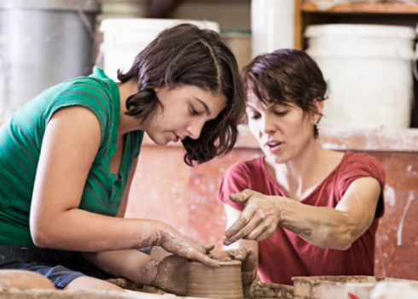
What careers can Art take me into?
App Design
Architect
Art Therapists
Book Illustrator
Cake Decorator
Ceramics Designer
Comic Book Creator
Costume Designer
Digital Imaging
Fashion Designer
Film Producer
Florist

Slide 15
What careers can Art take me into?
Glass Blower
Graphic Designer
Hairdressing
Product Designer
Interior Designer
Jewellery Designer
Make-up Artist
Model Maker
Photographer
Printmaker
Production Designer
Prop Maker
Street Artist
Stylist
Textile Designer
Set Designer
Software Designer

Slide 16
For more information on how to get a job in Art and Design you could watch:
https://www.youtube.com/watch?v=zf_tBRvCczo

Slide 17
What could you research next?
For more information on Creative Industries in the UK:
http://www.thecreativeindustries.co.uk/resources/infographics
Watch videos from real people who have been filmed at work, talking about their jobs. An excellent way to find out firsthand what day to day activities are involved in different careers.
www.careersbox.co.uk and www.icould.com/watch-career-videos/

