Slide 1
Preparing for Excellence Year 11 Information Evening
Presentation will begin at 4.30
Notes:
Welcome to parents, carers and students to our Information Evening. Our aim here is to share with you the best advice we can to ensure you have all you need to support your child through the most important year at Mulberry Academy Woodside.

Slide 2
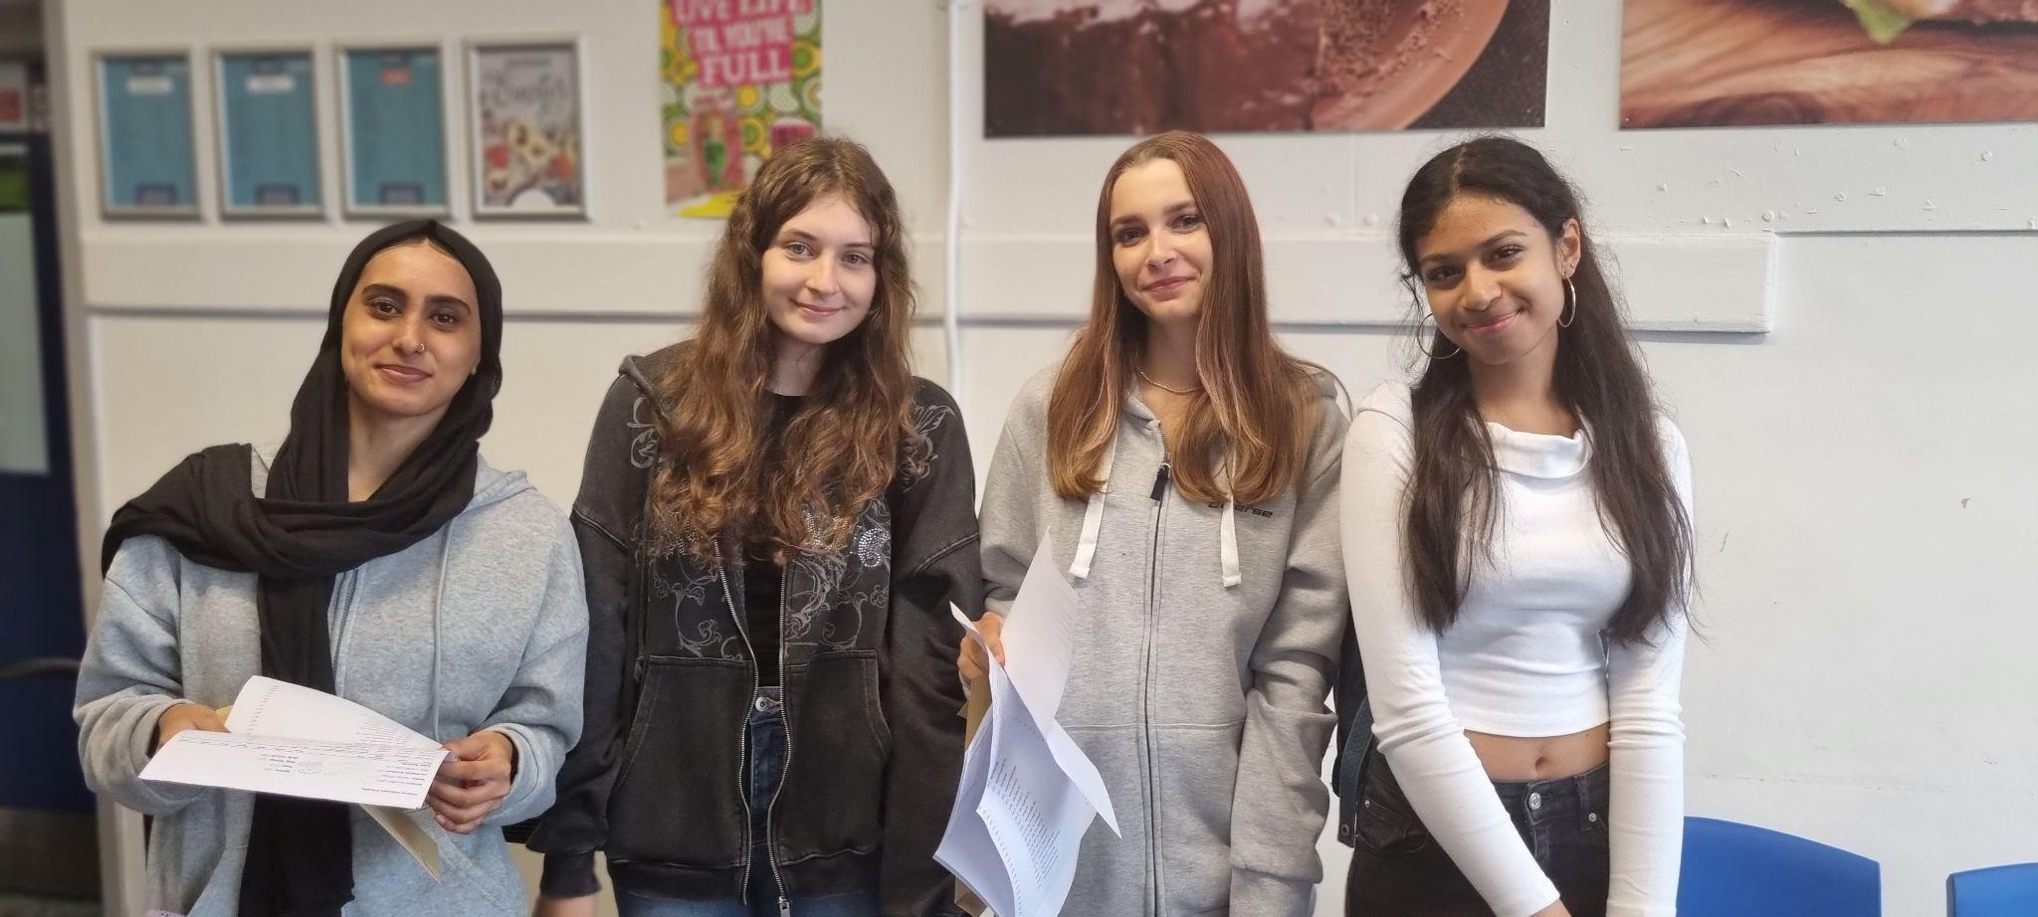
Students: Where do you want to be a year from now?
Notes:
As we go through the journey this year, you will need to keep reminding yourself of the end result, where you hope to be a year from now
Everything we do this year is about preparing our young people to have the best possible outcomes at the end of this year
We want your child to be able to make a choice about their future – this only comes from reaching their potential
The message we keep repeating to them- difficult year, we are in this together

Slide 3
The law requires that all young people continue in either in education or training until the age of 18. There are 2 main options:
1 Full time education 2 Apprenticeships
Options after year 11

Slide 4
1. Full time education
6th Forms, colleges and training providers offer a range of subjects and courses that can be studied full-time:
Subjects: A levels and other subject-based qualifications like T levels
NVQs and BTECs are good qualifications to take if you want to combine hands on, practical learning with studying subjects and technical skills.

Slide 5
To study three A Levels you need:
Five GCSEs at grades 9-4, including grade 5 in GCSE English Language and Maths
To study BTEC and other Level 3 courses you need:
Four GCSEs at grades 9-4, including grade 4 in GCSE English Language and Maths or relevant Level 2 qualification in a related subjects.
In addition to these general requirements, all courses have specific entry criteria- check the individual courses entry requirements for each 6th Form/Colleges.
Notes:
It is a government requirement that any student who has not achieved at least a grade 4 in English Language or Maths needs to continue with this subject as part of their study programme.

Slide 6
2. Apprenticeships:
Apprenticeship: A paid full time job with the added benefit of receiving training which leads to industry recognised qualifications or standards. Lasts a minimum of 12 months.

Slide 7
Notes:
Capital city college group

Slide 8
Preparing for the future
For the students…
Speak to your parents/carers and teachers, and make an appointment with Ms Ozcan.
Decide on your pathway: where do you want to be at 18 and 21, and what will get you there?
Consider your target grades, decide on your courses when you leave Woodside and research the best place to do your courses.
Prepare for your Mock Exams.
Visit, in person or ‘virtually’, at least three 6th Form/Colleges

Slide 9
The National Careers Service website has lots of information about different work sectors and job profiles of different types of career https://nationalcareersservice.direct.gov.uk
Notes:
Encourage your child to think carefully about their skills, interests and ambitions and help them to translate these into potential employment possibilities for the future.

Slide 10
Key dates: know what’s happening and when
Thursday 19th October | Careers Fair
Monday November 20 – Friday December 1st Dec | Mock Exams
January 11th 2024 | Year 11 Parents and Carers’ Event
March | Mock Exams
May 2024- onwards | GCSE Exams
Friday 22nd August | GCSE Results Day*
* dates subject to change

Slide 11
How can you support your child with their exam preparation
Help them create a revision timetable
Support them ordering their materials
Is there someone who can support with a challenging subject e.g. cousin
Is there a place at home eg the kitchen table which can be tidied for them to work on
Take their mobile during revision time

Slide 12
How can you support your child with their exam preparation
Ensure your child is in school every day and are on time.
Support your child with attending interventions and revision
Engage with their learning and follow up with any concerns
Description | Attendance % | Attendance in Days |  | Lost learning in hours
 |  | In | Absent
Excellent | 100% | 190 | 0 | 0 hours
Concern | 95% | 180.5 | 9.5 | 47.5 hours
Unsatisfactory | 90% | 171 | 19 | 95 hours
Serious Concern | 80% | 152 | 38 | 190 hours

Slide 13
Strategies that are effective
Making notes from your class notes
Using revision resources from teacher
Answering revision questions in course textbooks
Mind maps/ Diagrams/ knowledge dumps
Highlighting and summarising key information
Flashcards
Revision walls at home
Writing exam answers in timed conditions and using mark scheme to mark them
Reading model answers and comparing them to your own
Planning exam questions
One to one discussions with teachers and tutors

Slide 14
Supporting our young people at school
Detailed academic reports, three times a year
Quality first teaching
Structured tutor programme
Mock examinations- Monday Nov 20 – Friday Dec 1st Dec
Lunchtime supervised revision space
Booster sessions
Half term intervention
Online resources
Parents evening- Thursday 11th January
Visits from colleges and sixth form
Careers Advisor
Academic mentoring
Wellbeing mentors
Support with exam anxiety
Rewarding progress of students

Slide 16
Student wellbeing
Notes:
Student wellbeing:
watch out for stress;
encourage good eating and enough sleep;
be flexible around exams;
help them to study;
encourage exercise;
make time for treats.

Slide 17
How can you support wellbeing at home
Revision should be chunked, with breaks
Good sleeping patterns throughout the year
Limit screen time before bed
Take mobiles in the revision periods
Support regular exercise
Understand it will be challenging and stressful
Help support with goals- if this happens we can watch…

Slide 18
Thank you for attending

Slide 19
Y11 GCSE MATHEMATICS
Miss Yooyai – Head of Maths

Slide 20
Exam Board: Edexcel

Slide 21
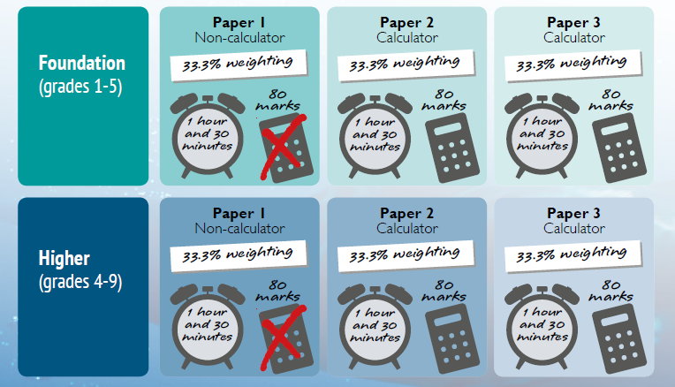

Slide 22
GCSE Mathematics Exams Summer 2024
Paper 1 Non-Calculator – Thursday 16th May 2024 AM
Paper 2 Calculator – Monday 3rd June 2024 AM
Paper 3 Calculator – Monday 10th June 2024 AM

Slide 23
Advance Information and Formulae Sheet
There will be no advanced information for Summer 2024.
There has been no confirmation from Edexcel as to the use of formulae sheets in Summer 2024 for Mathematics. Last year an announcement was made by the Department of Education on 1st December.
Until we hear otherwise, we will proceed under the assumption that there will be no formula sheet for Mathematics.

Slide 24
A Scientific calculator and geometry set can be paid for on ParentPay for £6 and collected from the Snack Shack.

Slide 25
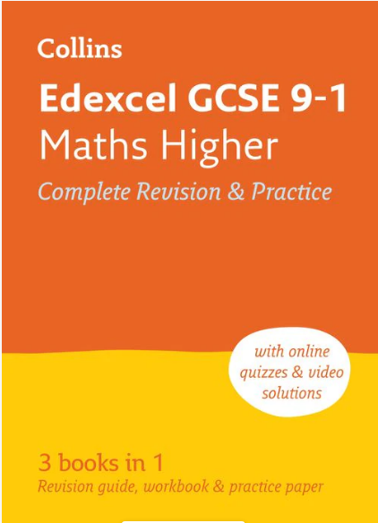
Revision guides provided

Slide 27
vle.mathswatch.co.uk
Logging into your account.
Your teacher will have given you your own username. This is:
Four numbers followed by @woodside.
(E.g. 1111@woodside)
For all students, the password is : ratio1

Slide 28
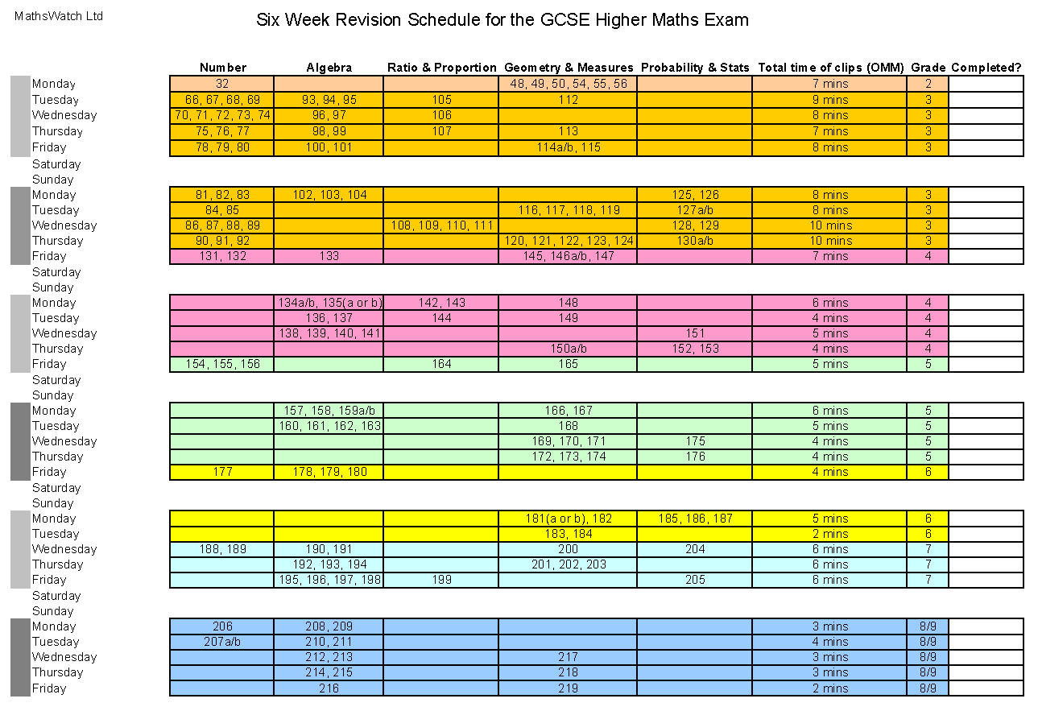
6 Week Revision Plan

Slide 29
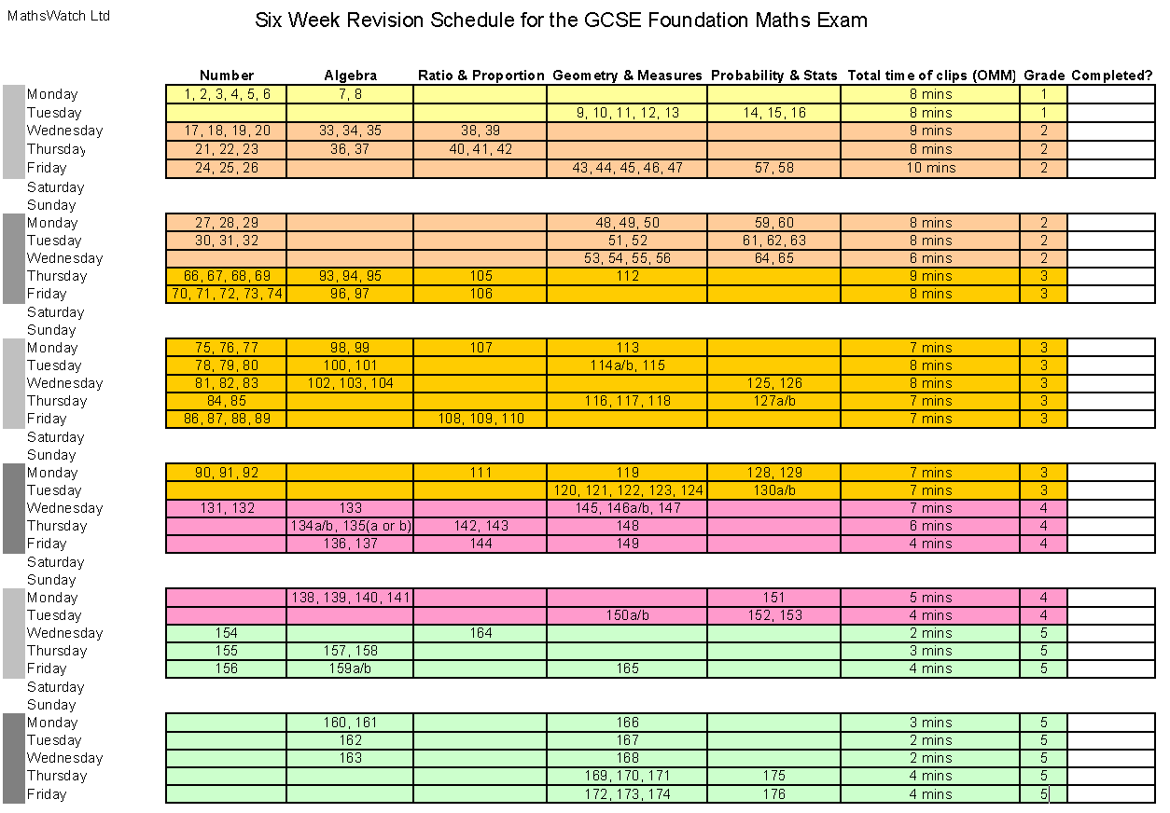

Slide 30
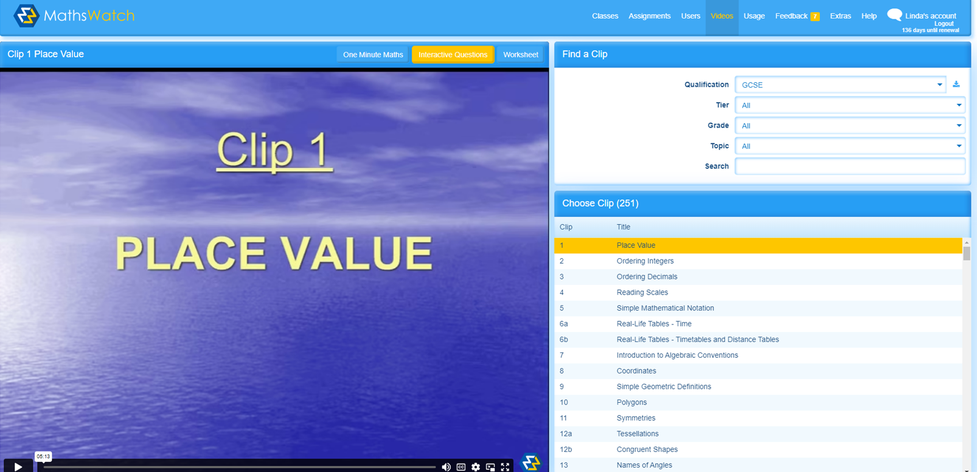
Select One Minute Maths
2. Select the clip number by searching here

Slide 31
https://corbettmaths.com/

Slide 32
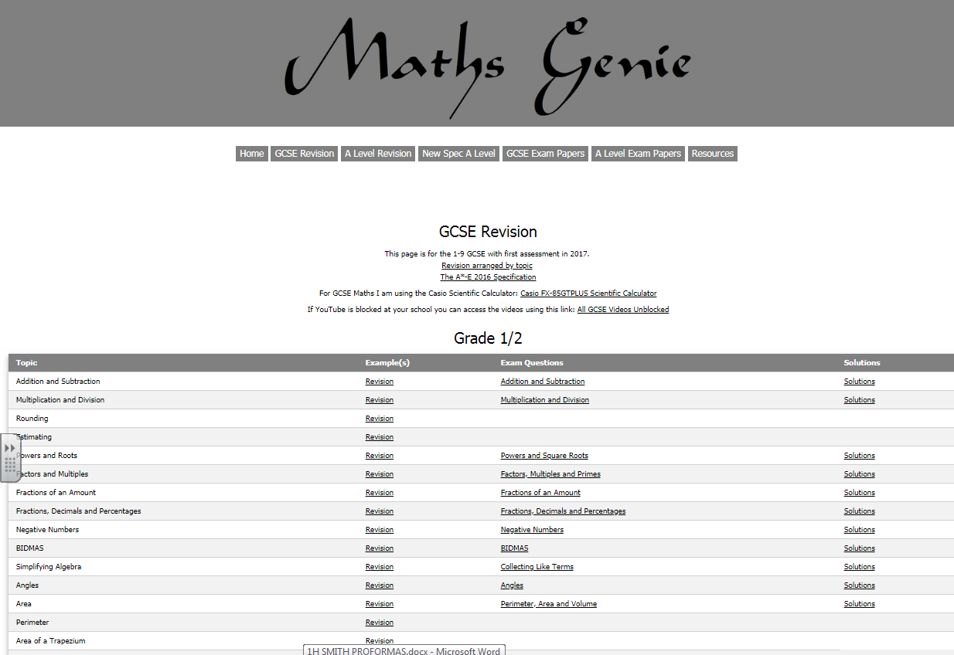
https://www.mathsgenie.co.uk/gcse.html

Slide 33
Active Revision in Maths
DO REGULAR REVISION EACH DAY
ANSWER EXAM QUESTION UNDER EXAM CONDITIONS
ANY REVISION YOU DO WILL BOOST YOUR CONFIDENCE AND YOUR GRADE
SEE YOUR TEACHER FOR EXTRA HELP

Slide 34
Y11 GCSE English
Ms Cuthbert

Slide 35
AQA GCSE English Literature
Paper 1 40%
Paper 2 60%
Section A:
Shakespeare
‘Macbeth’
Section B:
19th Cent Prose
‘A Christmas Carol’
Section A:
Modern Texts
‘An Inspector Calls’
Section B:
Anthology poetry.
Section C:
Unseen Poetry
Total exam time:
1 hour and 45 minutes
Total exam time:
2 hours and 15 minutes
All exams will be at the end of Year 11. You will also sit an English Language GCSE.

Slide 36
AQA GCSE English Language
Paper 1 50%
Paper 2 50%
Section A:
Reading (40 marks)
One text
1 short form question
2 longer form questions
1 extended question
Section B:
(40 marks)
1 extended narrative or descriptive writing question
Section A:
Reading (40 marks)
Two linked texts
1 short form question
2 longer form questions
1 extended question
Section B:
(40 marks)
1 extended transactional writing question
Total exam time:
1 hour and 45 minutes
Total exam time:
1 hour 45 minutes

Slide 37
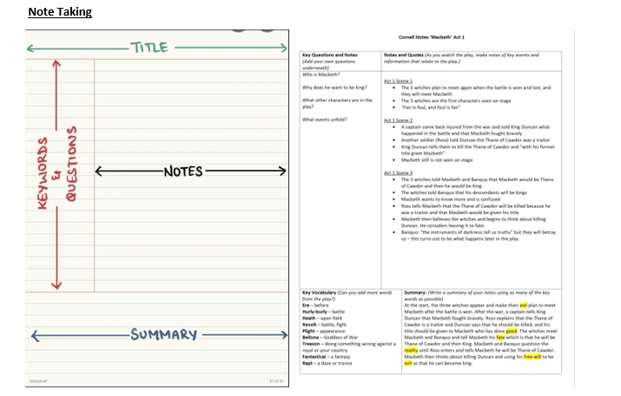
Revision Strategies ‘Work smarter not harder’
Cornell notes

Slide 38
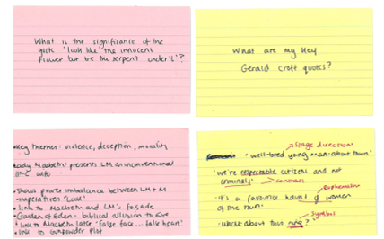
Revision Strategies ‘Work smarter not harder’
Flashcards and self quizzing

Slide 39
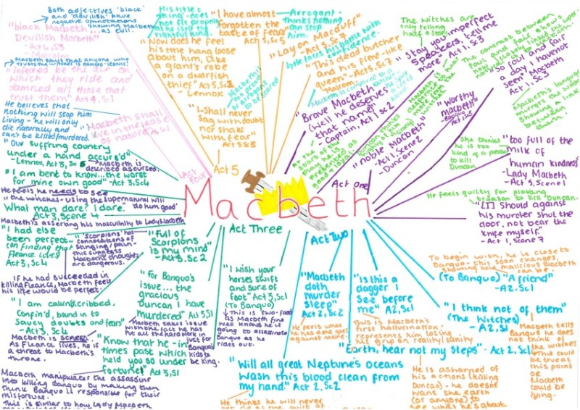
Revision Strategies ‘Work smarter not harder’
Knowledge dumps

Slide 40
Revision Resources

Slide 41
Revision Resources

Slide 42
Revision Resources
Seneca
Tassomai
PiXL

Slide 43
CGP Guides
Available on parent pay
Students can collect from B013

