Slide 1
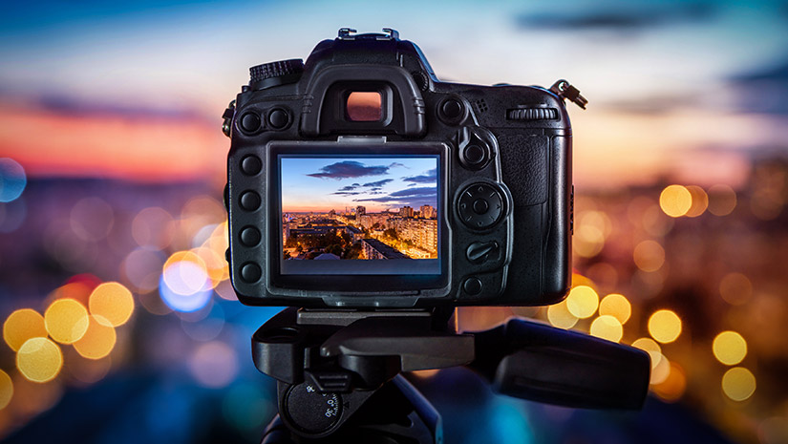
Why Study Photography?

Slide 2
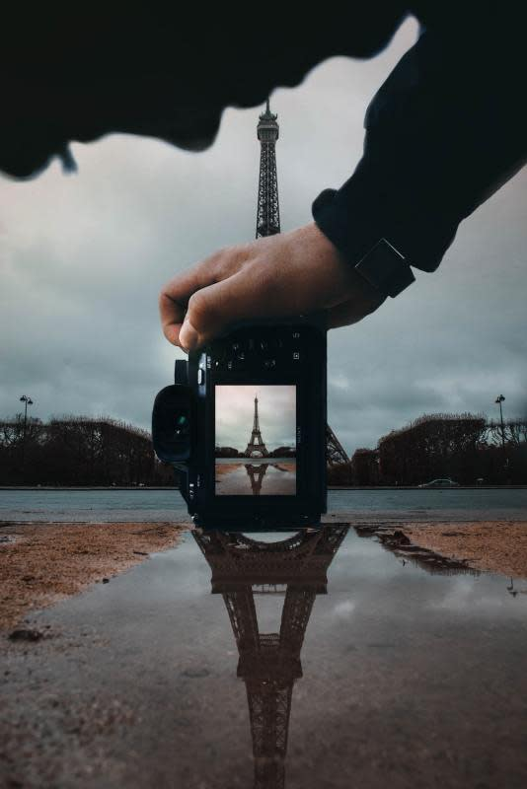
Common misconceptions around Photography
You have to have a really expensive camera to do photography.
Photography GCSE won’t get you anywhere.
You have to be an expert at Photoshop.
You need to know everything about cameras.
I can only become a freelance photographer if I study photography.
I’m not arty I cant do photography.
I wont be able to get a good career if I study photography.

Slide 3
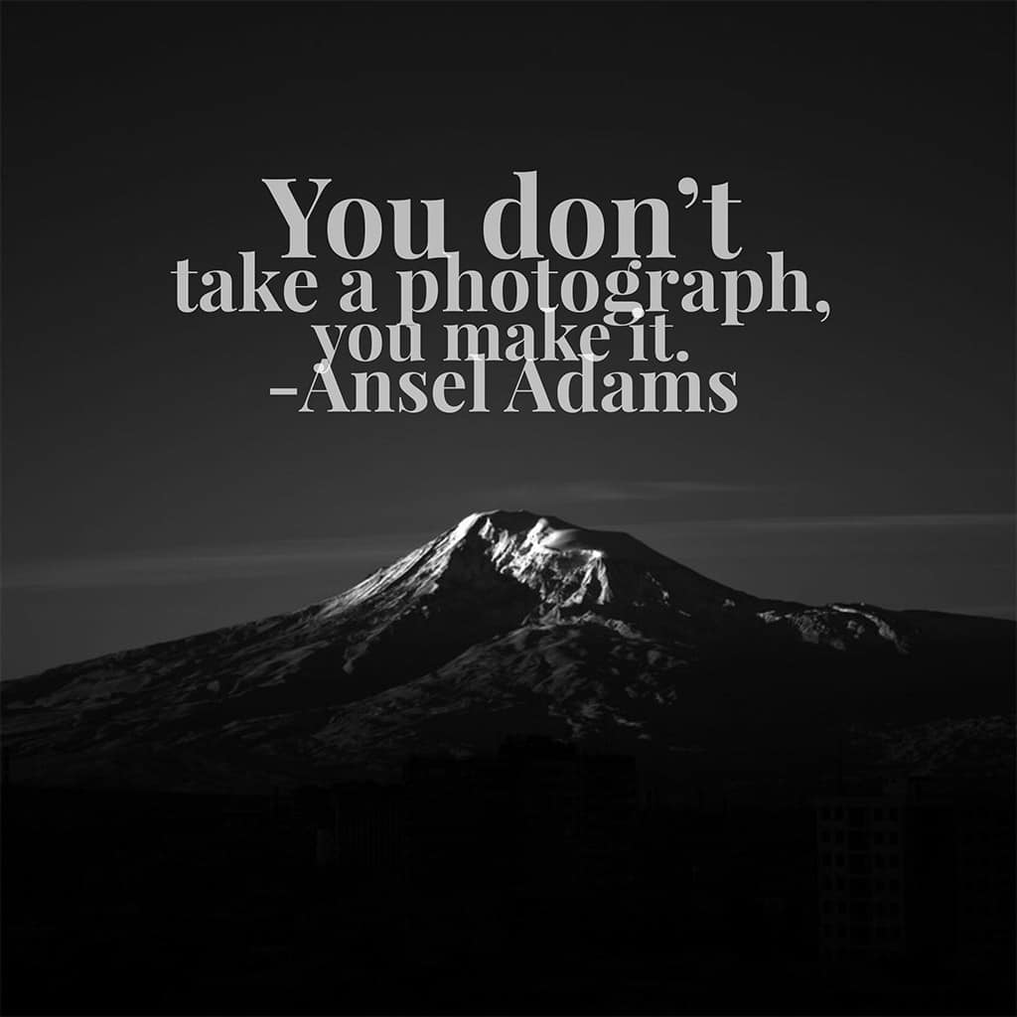
Why study Photography?
To express yourself
Understand the world around you better
One of the few GCSE subjects left with a large amount of practical coursework towards your final grade.
Explore social, moral, cultural, historical and political issues. E.g. Women’s rights, animal cruelty, Scientific experiments.
Gain skill in editing using software like Photoshop and Lightroom

Slide 4
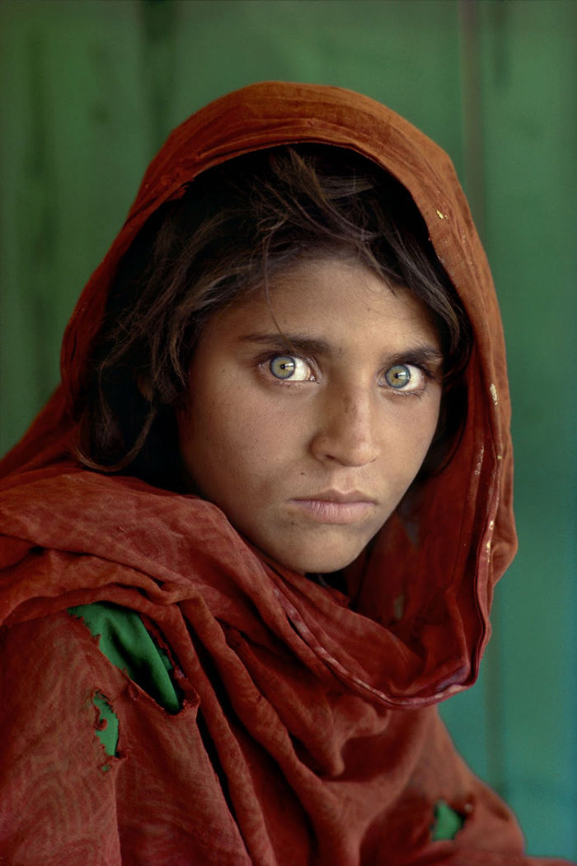
What can you learn with Photography?
Decision making, risk taking and problem solving.
Resourcefulness
Camera knowledge – aperture, shutter speed, ISO, lighting, depth of field.
Develop a good eye for compositions
Film photography – Dark rooms, chemical developing
Computer skills
Portraiture – Lighting, studio, fashion photography
Documentary photography
Night time photography (astrological)
Stop motion/Animation
Polaroid cameras
Video making
Installations – Exhibitions
Curating

Slide 5
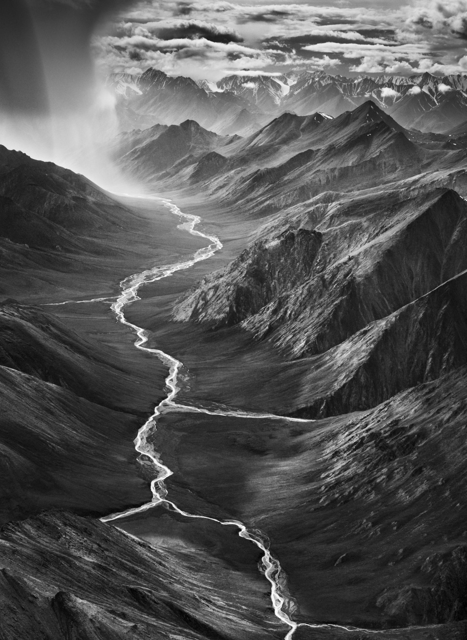
What careers can photography take me into?
App Design
Architect
Website designer
Wedding photographer
Fashion photographer
Journalism
Film Producer
Technician
Photo editor
Art director
Videographer
Magazine Photographer
Events Sports Photographer
Freelance
Social Media
Digital Marketing
Graphic Designer
Forensics
Curator

Slide 6
How will you be assessed?
How you bring together the knowledge, understanding and skills you’ve acquired.
How you make connections between knowledge, understanding and skills when engaging with sources such as the work of photographers, artists, and designers.
How you develop responses to initial starting points, project briefs or specified tasks and realise intentions informed by research, the development and refinement of ideas and meaningful engagement with selected sources.
How you actively engage in the creative process of photography in order to develop as effective and independent learners, and as critical and reflective thinkers with enquiring minds.
How you develop creative, imaginative and intuitive capabilities when exploring and making images, artefacts and products.
Taking risks and learn from experience when exploring and experimenting with ideas, processes, media, materials and techniques.
Develop critical understanding through investigative, analytical, experimental, practical, technical and expressive skills.
Develop and refine ideas and proposals, personal outcomes or solutions with increasing independence.
Acquire and develop technical skills through working with a broad range of media, materials, techniques, processes and technologies with purpose and intent.
Assessment objectives:
Assessment objectives (AOs) are set by Ofqual and are the same across all GCSE Art and Design specifications and all exam boards. The exams and non-exam assessment will measure how students have achieved the following assessment objectives.
AO1: Develop ideas through investigations, demonstrating critical understanding of sources.
AO2: Refine work by exploring ideas, selecting and experimenting with appropriate media, materials, techniques and processes.
AO3: Record ideas, observations and insights relevant to intentions as work progresses.
AO4: Present a personal and meaningful response that realises intentions and demonstrates understanding of visual language.

